Slide 1
CA169
Networks & Internet
Lecturer & Co-ordinator
Brian.Stone@DCU.IE

Slide 2
The Course (indicitive)
Layered Network Architectures.
History of the Internet
Physical Issues, Data Encoding, etc..
The Data-Link Layer
  The 802 protocols
  Wired & Wireless Networks
The Web
Network Devices
Communications Protocols
Local area networks (data link layer)
Internet Protocols
Tying together MAC, IP and TCP addressing and introducing URLs
Network tools

Slide 3
Indicative Assignments and Lab work
Generating HTML for the Web
Networking tools – Using Wireshark
Wireshark traffic capture and analysis exercises (several)
  Web browsers
Moodle quizzes
Network survey

Slide 4
Course Structure
This course
  Small timetabling differences later in semester
  Exam worth 50%
  Assignments worth 50%
  Repeats possible for assessments and exams.
2 lectures per week (for now)
Labs on occasions (some online)
Moodle for distributing notes and collecting assignments.

Slide 5
Lecture Notes
CA169

Slide 6
What is a network?
Two or more computers linked together to share resources
  Share files, printers, electronic communication etc.
  Linked through cables, telephone lines, radio waves, satellites or infrared beams.
Four basic types of networks
  Local Area Network (LAN)
  Personal Area Networks (PAN)
  Metropolitan Area Network (MAN)
  Wide Area Network (WAN)

Slide 7
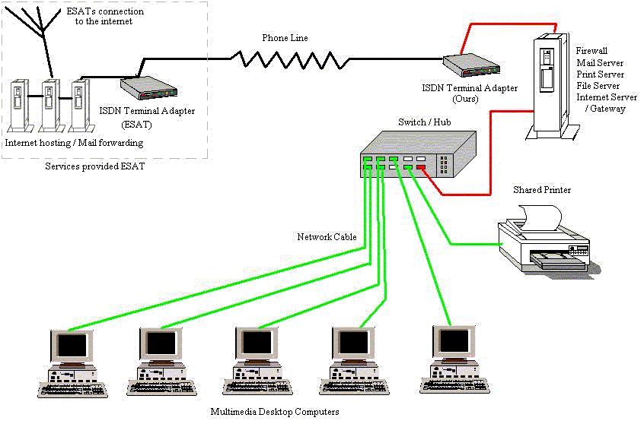
Local Area Network
Network confined to a relatively small geographic area. Typically lab in CA, office etc.
Typical LAN has a central server which controls the network. Can share resources ….printers, files. Should be more powerful than the clients.

Slide 8
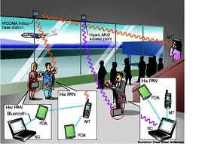
PAN
Tends to be wireless WPAN
Phone talking to organiser or Internet
May be carried over
  Ethernet
  WiFi
  NFC
  IR
  Bluetooth
  ZigBee

Slide 9
Metropolitan Area Network
Covers larger geographic areas, cities, schools, local libraries, government offices
Typically uses dedicated phone lines, coaxial cabling, fibre optic cable and wireless communication

Slide 10
Wide Area Network
Connects larger geographic areas, such as global companies. Local and global networks are connected to form larger network.
Typically uses transoceanic or satellite links
Protocols used can be ATM networks or MPLS (carrying Ethernet) or others.
Typically use special hardware and special fibres.
Physical layer can be DWDM

Slide 11
The Internet
All of the previous network types can connect to the internet
Infrastructure software needed – TCP\IP
Global services available through Internet
Internet aware applications
Network aware devices
The Internet has transformed the way we do things!

Slide 12
Topology

Slide 13
Network Topologies
Topology is how the cables, computers and other peripherals are connected
Different types of topologies
  Star
  Ring
  Bus
  Tree
  Complete
  Irregular

Slide 14
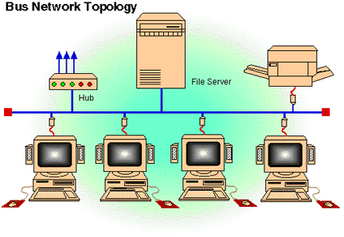
Bus Topology

Slide 15
Bus Topology (2)
Computers share the same bus (cable) with a terminator at each end. Each client is connected to the bus.
  Old Ethernet on coaxial cable utilises a bus
Simple and reliable, not much hardware needed.
Inexpensive cable and easy to expand
  Uses the least cable
  Management more problematic
Heavy traffic slows overall throughput
A break in network brings whole thing down. Can be difficult to detect.

Slide 16
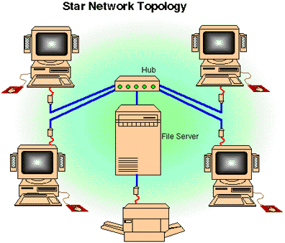
Star Topology
Switch
Check out the cabinets in our labs.

Slide 17
Star Topology (2)
Each node connected directly to central computer. All data must go through central node (hub/switch)
Relies heavily on central computer
Each device has a separate wire. Easy to install new devices. Disconnecting / Adding devices does not interrupt network. Easy to detect breaks/faults
More cable is required (look at our cabinets)
If central node fails, network falls over
Commonly uses twisted pair, also uses co-axial (rare now) cable and fibre optics

Slide 18
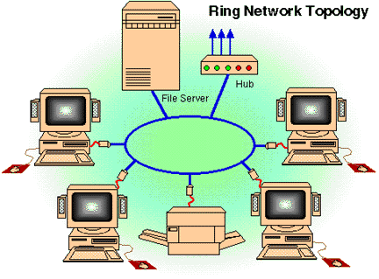
Ring Topology

Slide 19
Ring Topology (2)
Computers tied together in a ring
Each device is connected to the next one in line
Circle of cable
Signal travels in one direction
When a device receives control (token)
  It acts on it
  or passes it on
Not common these days for LAN.

Slide 20
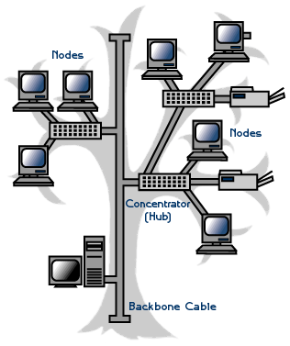
Tree Topology
Modern LANs utilise Switches to build a tree topology, even when the network looks like a mesh.
Need to ensure that loops are not introduced, special protocols built into switches (STP)

Slide 21
Topology Considerations
Money
  Bus cheapest, no need for central node
  But what about management cost?
Length of cable
  Bus uses shortest cable, but how expensive is cable anyhow?
Efficiency
  Star topology easies to add new nodes
  Manage existing infrastructure
Cable type
  Most common cable is twisted pair, most often used with star topologies

Slide 22
Network Architecture
Need to break down idea of a network into easily understood abstractions – use layered architecture

Slide 23
Layered Architectures
The ISO defines a 7 layer Architecture.
TCP\IP is defined as a 4 layer Architecture.
ISO is a prescriptive Architecture
TCP\IP is descriptive.

Slide 24

OSI Model
7
Application
Application
7
6
Presentation
Presentation
6
5
Session
Session
5
4
Transport
Transport
4
3
Network
Network
3
2
Data Link
Data Link
2
1
Physical
Physical
1
Physical Network

Slide 25
OSI (2)
7. Application Layer (Top Layer)
6. Presentation Layer
5. Session Layer
4. Transport Layer
3. Network Layer
2. Data Link Layer
1. Physical Layer (Bottom Layer)

Slide 26
OSI (3)
The Application layer represents the level at which applications access network services. This layer represents the services that directly support applications such as software for file transfers, database access, and electronic mail.
The Presentation layer translates data from the Application layer into an intermediary format. This layer also manages security issues by providing services such as data encryption, and compresses data so that fewer bits need to be transferred on the network.
The Session layer allows two applications on different computers to establish, use, and end a session. This layer establishes dialog control between the two computers in a session, regulating which side transmits, plus when and how long it transmits.

Slide 27
OSI (4)
The Transport layer handles error recognition and recovery. It also repackages long messages when necessary into small packets for transmission and, at the receiving end, rebuilds packets into the original message. The receiving Transport layer also sends receipt acknowledgments.
The Network layer addresses messages and translates logical addresses and names into physical addresses. It also determines the route from the source to the destination computer and manages traffic problems, such as switching, routing, and controlling the congestion of data packets.
The Data Link layer packages raw bits from the Physical layer into frames (logical, structured packets for data). This layer is responsible for transferring frames from one computer to another, without errors. After sending a frame, it waits for an acknowledgment from the receiving computer.

Slide 28
OSI (5)
The Physical layer transmits bits from one computer to another and regulates the transmission of a stream of bits over a physical medium. This layer defines how the cable is attached to the network adapter and what transmission technique is used to send data over the cable.

Slide 29
TCP/IP & OSI
TCP/IP
OSI
Application
Application
7
Presentation
6
5
Session
5
4
Transport
Transport
4
3
Internet Protocol
Network
3
Transport
2
Network Interface
Data Link
2
1
Physical
Physical
1

Slide 30
TCP/IP & OSI (2)
The OSI model is the seven layer Open Systems Interconnection model. It was developed to serve as a standard model for network architectures. Transmission Control Protocol / Internet Protocol (TCP/IP) is the protocol on which the Internet is based upon. It has five layers and they are related to the OSI model as above.
Information is transmitted around the Internet in packets. These packets contain among other things the destination and source addresses of the packet and the data. The protocol used is TCP/IP. Internet Protocol is protocol, which sends packets around the Internet. TCP sits on top of IP and it guarantees reliable delivery of packets for applications such as FTP and Telnet. An end-to-end connection is open for the delivery session between two applications.

Slide 31
Meet Some of the
TCP/IP Family
Telnet
FTP
SMTP
SNMP
1
2
3
4
TCP
UDP
IP
Arpanet
802.11WiFi
802.3 LAN

Slide 32
Why Two Models
OSI concepts
  Services (definition)
  Interfaces (how to access)
  Protocols (peer protocols, private)
Kind of OO approach, encapsulation.
Prescriptive & Descriptive origins
  Simple services, interfaces, protocols

Slide 33
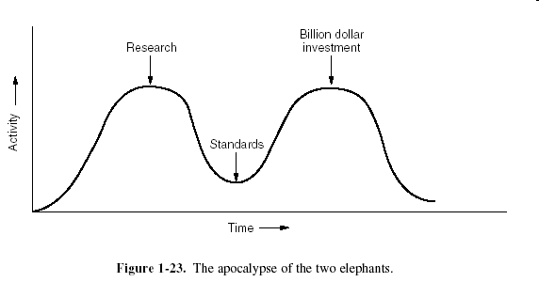
Why Two Models (cont.)
Bad Timing
  Apocalypse of Two elephants (research & investment)
Bad technology.
  Copying proprietary SNA.
  Empty layers.
  Cross a mobster with a standard…
    you get made an offer that you cannot understand.

Slide 34
Physical Layer
Host-to-Network Layer of TCP/IP

Slide 35
Physical Layer Issues
Attenuation & Data Rates.
Nyquest’s Theorem
  Max rate = 2H bps (H is bandwidth in Hz)
Shannon’s Theorem
  Max rate = H log₂ (1 + S/N) bps
  Shannon takes noise into account.

Slide 36
Media

Slide 37
Coaxial Cable
Like your TV cable at home
Single copper conductor at centre with plastic layer providing insulation between conductor and braided metal shield. Shield prevents interference
Supports longer cable length the UTP
Thin coaxial (10Base2)
  Max segment length 185M
Thick coaxial (10Base5)
  Max segment length 500M

Slide 38


Coaxial Cable (2)
Coaxial Cable
BNC Connector

Slide 39
Unshielded Twisted Pair
Cable has 4 pairs of wires, twisted in pairs
UTP can be telephone grade to high-speed cable
5 categories
  1 voice only
  2 Data up to 4 Mbps
  3 Data up to 10 Mbps
  4 Data up to 20 Mbps
  5 Data up to 100 Mbps
Can be susceptible to radio and electrical interference. Shielded Twisted Pair exists, but extra shielding makes it bulky

Slide 40
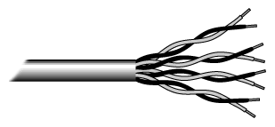
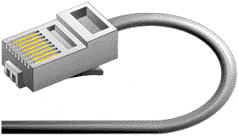
Unshielded Twisted Pair (2)
Unshielded twisted pair
RJ-45 Connector

Slide 41

Fibre Optic
Centre glass core surrounded by layers of protection
Transmits light rather than electrical signals Not susceptible to electrical interference
Capable of transmitting data over longer distances and at higher speeds than coaxial and TP
10BaseF
Outer coating is made from Teflon or PVC
Plastic helps cushion glass core
Kevlar around plastic strengthens cable and prevents breakage
Fibre Optic Cable

Slide 42
Security and Fibre Networks
From a security perspective, one of the great advantages of fibre networks is that they do not radiate any electromagnetic signals
There is a prevalent myth that fibre networks cannot be tapped: with physical access to the cable, they can
However, it is considered impossible to tap an optical cable without introducing a detectable increase in attenuation. A secure system should continuously monitor received optical signal strength and should alert on any abrupt change

Slide 43
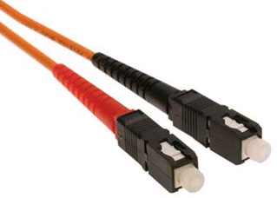
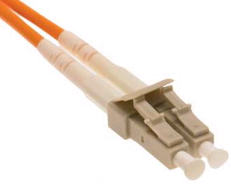
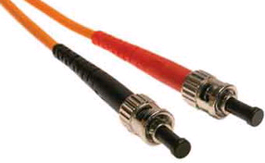
Connectors
SC – In widespread use. Used on the original Gigabit Ethernet GBICs
LC – Used in newer cabling installations. Used on new small form factor (SFP) GBICs
ST – “Bayonet” mount, often used on older fibre installations

Slide 44
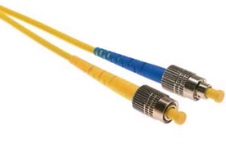
Connectors
FC – Screw mount. Only ever found on carrier-grade equipment (and usually with higher-powered lasers…don’t look into these)

Slide 45
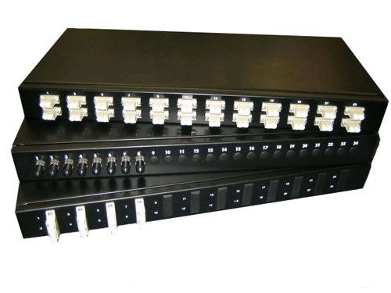
Patch Panels
Fibre within or between buildings are typically terminated on patch panels like these
Fibre patch cables are used to link active equipment to the patch panels

Slide 46
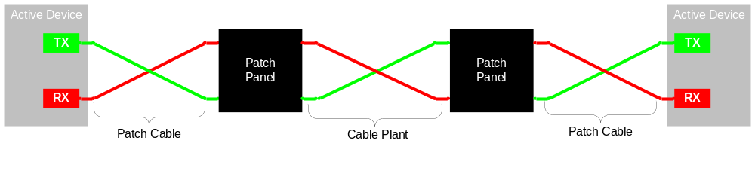
Patch Panels
In order to ensure that Transmit is always connected to Receive in each direction, patch leads and internal cable plant are always (supposed to be) crossed over
This means that you can use a patch cable on its own to link two physically adjacent devices

Slide 47
Laser Safety
Lasers are categorised into various classes according to the amount of optical power they emit. It is important to know what these mean:-
Class 1 | The output power is below the level at which it is believed eye damage will occur. Exposure to the beam of a Class 1 laser will not result in eye injury and may therefore be considered safe
Class 2 | A person receiving an eye exposure from a Class 2 laser beam, either accidentally or as a result of someone else's deliberate action (misuse) will be protected from injury by their own natural aversion response

Slide 48
Laser Safety
Class 3R | The laser beams from these products exceed the maximum permissible exposure for accidental viewing and can potentially cause eye injuries, but the actual risk of injury following a short, accidental exposure, is still small.
Class 3 | Class 3B lasers may have sufficient power to cause an eye injury, both from the direct beam and from reflections.
Class 4 | Have an output power greater than 500 mW (half a watt). There is no upper restriction on output power. Capable of causing injury to both the eye and skin and will also present a fire hazard if sufficiently high output powers are used.

Slide 49
Laser Safety
In “enterprise” communications equipment, lasers more powerful than Class1 are rarely encountered (but always check !).
Class 3 lasers are sometimes encountered in long-haul, DWDM carrier networks.

Slide 50
Radio
Wireless LAN
No cables
High frequency radio signals
Each workstation has a transceiver / antenna
Also includes mobile phone technology, microwave transmission, satellite for longer distances
Expensive, history of poor security (now down to ignorance, strong encryption available now),
Susceptible to interference
  More on this later

Slide 51
Transmission Errors
Errors due to following factors
  Thermal noise.
  Impulse noise.
  Signal distortion.
Impulse is worst offender.
Must provide methods of error detection and correction.

Slide 52
Cyclic Redundancy Code CRC
Error Detecting Code (not correcting!)
Nomenclature
  A string of N bits may be represented as an N-1 degree polynomial with co-efficient of 0 or 1.
  F = 110001
  F(x) = x⁵ + x⁴ + x⁰
Modulo 2 arithmetic.
  Addition and Subtraction identical… XOR

Slide 53
CRC Algorithm
Sender & receiver agree on G(x) generator polynomial.
Append R 0 bits to M(x), the message, where R is the degree of G(x), this yields
  x^{R} * M(x)
Divide G(x) into x^{R} * M(x).
Add remainder to x^{R} * M(x), result T(x)

Slide 54
CRC Example
M(x) = 1101 0110 11
x^{R} * M(x) = 1101 0110 1100 00
G(x) = 10011 or x⁴ + x¹ + x⁰
Remainder should be 1110
T(x) transmitted message should be
  1101 0110 11 1110
This will be evenly divisible by G(x) !

Slide 55
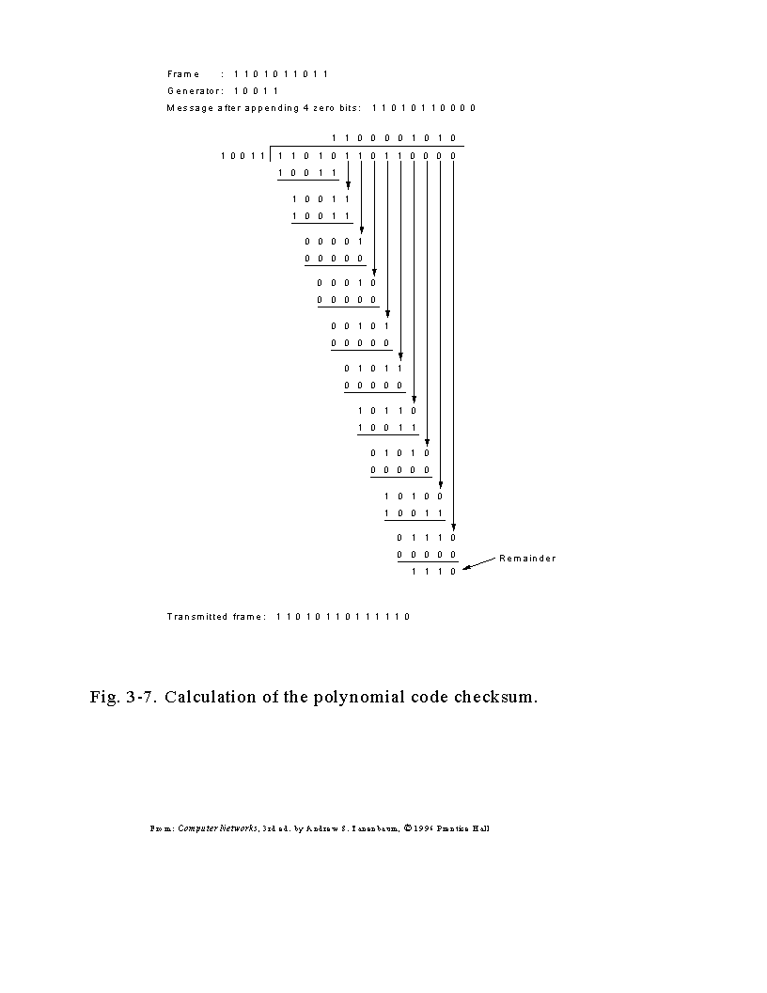

Slide 56
Standard CRCs
CRC-12
  x¹² + x¹¹ + x³ + x² + x + 1
CRC-16
  x¹⁶ + x¹⁵ + x² + 1
CRC-CCITT
  x¹⁶ + x¹² + x⁵ + 1
CRC-32
  x³² + x²⁶ + x²³ + x²² + x¹⁶ + x¹² + x¹¹ + x¹⁰ + x⁸ + x⁷ + x⁵ + x⁴ + x² + x + 1

Slide 57
Signalling AM, FM, PM
Modems use analogue signals down a telephone line
Digital signals must be converted to analog signals for this
Nyquest pointed out that it is not possible to merely keep increasing the sampling rate, so even with perfect 3000Hz line, no point in sampling faster than 6000Hz

Slide 58
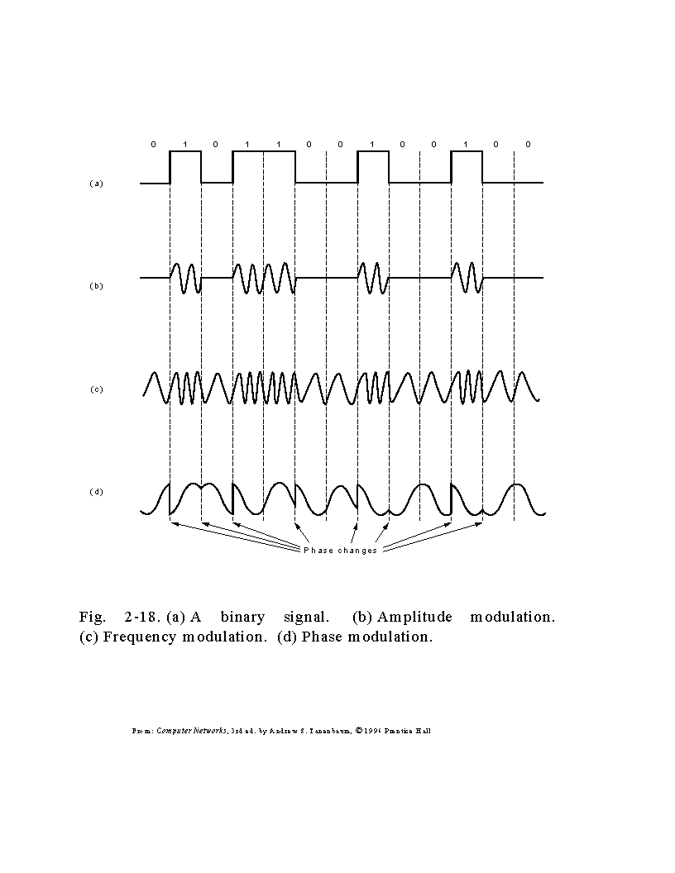

Slide 59
Digital Encoding
NRZ- L and NRZ- I
Manchester
Differential Schemes
Differential Manchester
4B\5B
Issues of efficiency and clocking.

Slide 60
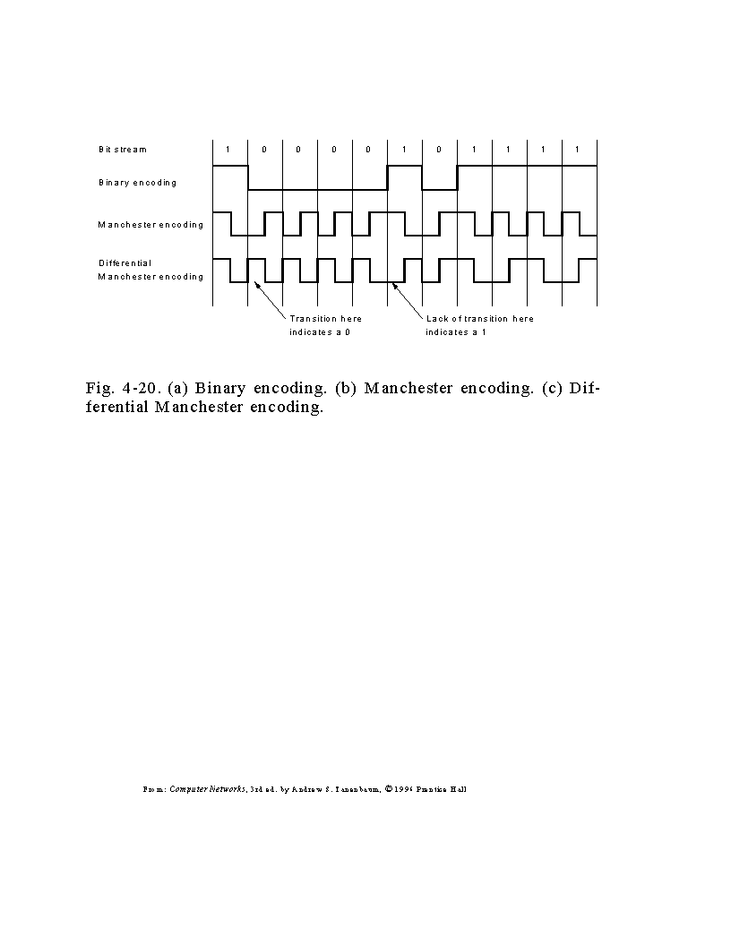

Slide 61
Encoding (Notes)
NRZ-L is used for short connections (RS232) but not for longer connections. Positive denotes a ‘0’ and negative denotes a ‘1’. (L refers to level).
NRZ-I (Inverted) is a differential scheme where a transition denotes a ‘1’, and no transition denotes a ‘0’. With differential coding schemes a signal is decoded by comparrison of the polarity of adjacent signal elements, rather than determining the absolute value of a signal element.

Slide 62
An advantage of this scheme is that it may be more reliable to detect a transition, in the presence of noise, rather than to compare a value to a threshold. Differential encoding on a twisted pair medium is also immune to the wires being crossed as the thresholds are not being examined, but the transitions are. After all a transition from +’ive to -’ive is just as much a transition as from -’ive to +’ive.
There is a requirement for clocking information to be embedded in the data. One technique which does this is called Manchester Encoding, and a variation on it is called Differential Manchester Encoding. These schemes are called biphase codes.
In the binary encoded signal there is no clock information, i.e. nothing to differentiate repeating digits.

Slide 63
In Manchester Encoding, each bit period is divided into two equal intervals, thus the name biphase. There is always a transition between these intervals (thus clocking). A binary ‘0’ is represented as having the first interval set high and the second interval set low. A binary ‘1’ is the reverse -- the first interval is low and the second high.
Advantage: always a transition in each bit, thus making synchronisation between sender and receiver possible.
Disadvantage: requires twice as much bandwidth as plain binary coding.
Differential Manchester Encoding scheme distinguishes 1’s and 0’s by using a transition at the start of a period to indicate a ‘0’ and no transition to represent a ‘1’. A transition in the middle of the period between the two intervals is still used to help provide clocking information, just as in Manchester Encoding.

Slide 64
This differential scheme is more complex to operate but is more immune to noise. An error must invert the signal before and after expected transitions to cause undetected errors. It also requires twice the bandwidth of ordinary binary encoding.
In differential encoding schemes, it is the transition from one voltage level to another that distinguishes bit values, not the voltage levels. This makes the coding scheme more immune to noise.
If there are two wires carrying a signal from one device to another and the wires are accidentally confused, then this does not affect the interpretation of the data as the transitions in voltage levels will still be correctly interpreted. The signal levels are not important, only the transition from one state to another.

Slide 65
4b\5b Coding
Greater efficiency may be achieved than that of Manchester Codes (50%). One such better scheme is 4B/5B.
Each four bits are coded in a symbol with 5 cells where each cell contains a single signal element. So each group of four bits (nibble) is encoded as 5 bits. This raises the efficiency to 80% for this scheme, as opposed to Manchester encodings 50%.
Synchronisation is achieved by including a second stage of encoding. Each cell of the 4B/5B stream is treated as a binary value itself and encoded using a NRZI scheme. This takes on the advantages of differential encoding.

Slide 66
Only 16 of the possible 32 bit patterns generated from 5 bit code are required to represent the 4 bit data patterns.
The 5B codes selected to represent the 16 4-bit data blocks are such that a 1 is present at least twice for each 5-cell (or 5-bit) code.
This minimum transition rule aids synchronisation by including an element of clocking.
4b5b Coding is utilised in 100 Mb Ethernets

Slide 67
100 Mbps 4B5B Code
4-bit 5-bit
0 0000 11110
1 0001 01001
2 0010 10100
3 0011 10101
4 0100 01010
5 0101 01011
6 0110 01110
7 0111 01111
8 1000 10010
9 1001 10011
A 1010 10110
B 1011 10111
C 1100 11010
D 1101 11011
E 1110 11100
F 1111 11101

Slide 68
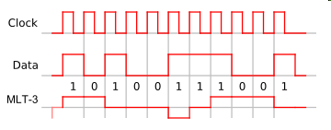

MLT
A 100 MHz data stream that uses a 4B/5B encoding results in a125 MHz signal.
125 MHz signal is itself encoded as a mult-level signal using three signal levels (instead of the two levels used in Manchester encoding).
The three signal levels are -1, 0, +1.
This reduces the bandwidth required on the physical cable to only 31.25 MHz, which is within the specification of the CAT5e cable used in UTP.

Slide 69
8b/10b Coding in Gigabit Ethernet (fiber)
The 10 bit code must contain either five ones and five zeros, or four ones and six zeros, or six ones and four zeros.
The difference between the count of 1s and 0s in a string of at least 20 bits is no more than 2, and there are not more than five 1s or 0s in a row
This prevents a sequence of too many consecutive ones and zeros, assisting clock synchronisation.

Slide 70
Framing Problem
Communication protocols break data stream into frames or packets.
Easier to multiplex several connections over one comms. channel.
Problem…
  Where does one frame begin and another end?

Slide 71
Solutions to Framing Problem
Timed Delay: fixed delay between frames.
  Delays may occur due to interrupts or breaks in transmission.
Character count: include a header which contains length of frame, cover with a CRC.
  If count becomes corrupted, may not find CRC and receiver loses synch.

Slide 72
Solutions to Framing Problem (cont.)
Character stuffing: mark start of each frame with sequence DLE STX and end with DLE ETX (byte oriented).
  What happens is DLE STX or DLE ETX occur naturally in the data? Solution - stuff it with another DLE! Receiver watches for double DLEs and destuffs them. Only true delimiters have a single DLE.

Slide 73
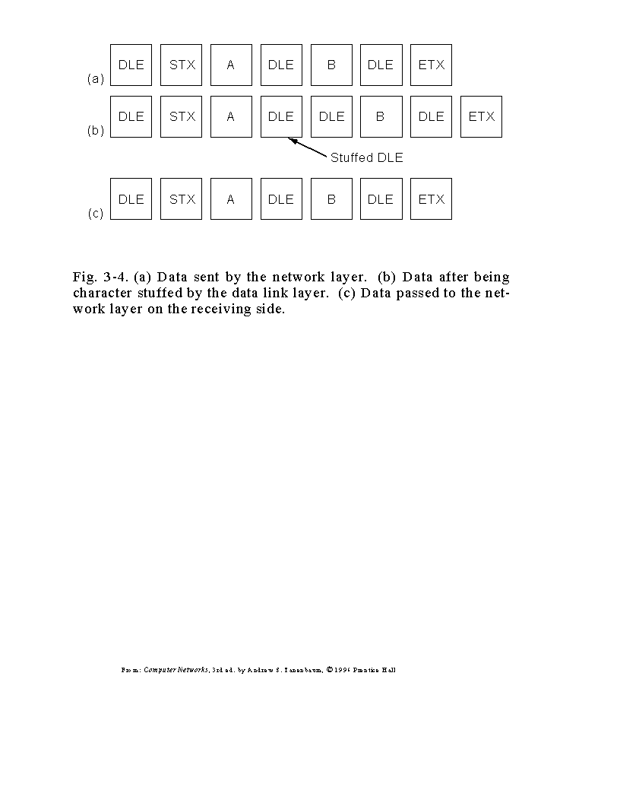

Slide 74
Solutions to Framing Problem (cont.)
Bit stuffing: Use unique bit sequence (bit oriented) such as 0111 1110 to mark start of frame.
  If this occurs in data, stuff it with a 0 after 5 consecutive 1s!
  Receiver de-stuffs five 1s followed by a 0, only 6 consecutive 1s is a real delimiter.

Slide 75
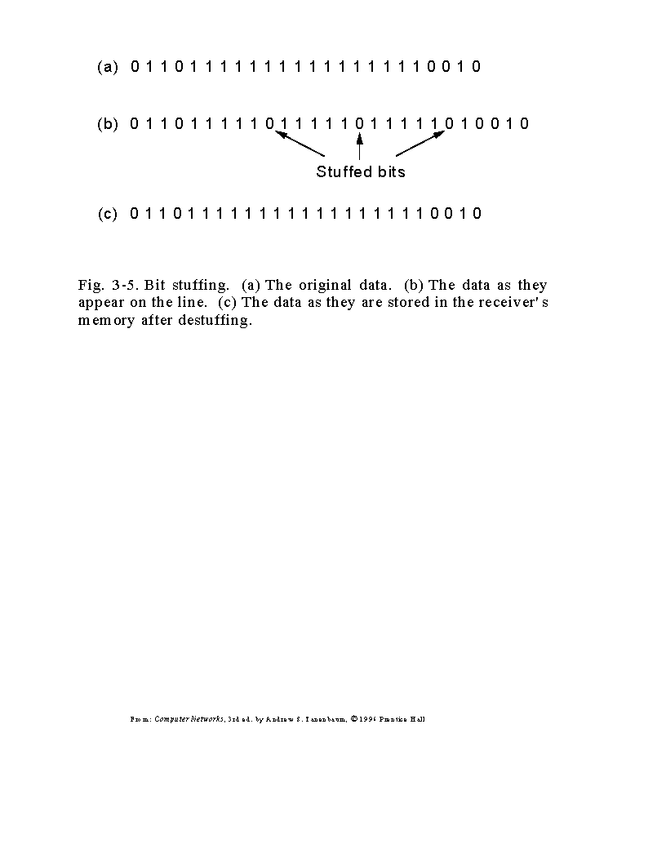

Slide 76
OSI Data Link Layer
Part of Network Access Layer of TCP/IP
Details Computer-to-Network Issues

Slide 77
Data Link Issues
Currency of Data-Link is frames or packets.
Issues to be addressed here are…
  Framing
  Error Control
  Flow Control
We have seen how frame and error detection are done, now we have to do something about lost or damaged frames.

Slide 78
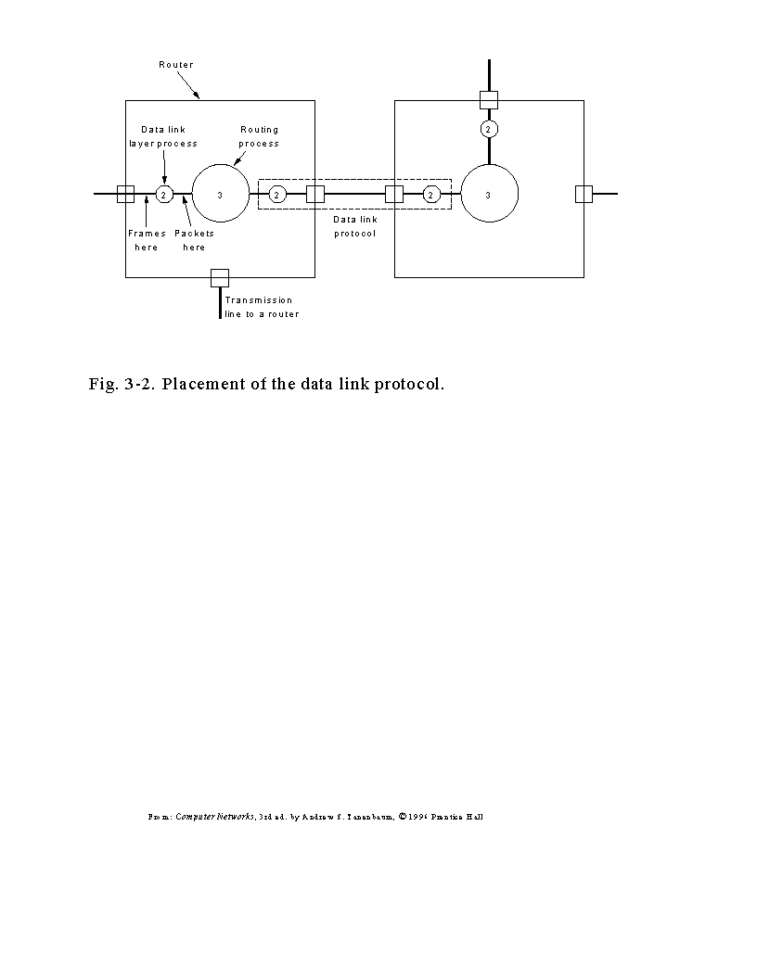

Slide 79
The Need For Protocols
Protocols are algorithms which will implement framing, flow control and error detection and correction.
Makes error prone physical layer appear as error free to higher layers.
Does so as efficiently as possible using valuable bandwidth.

Slide 80
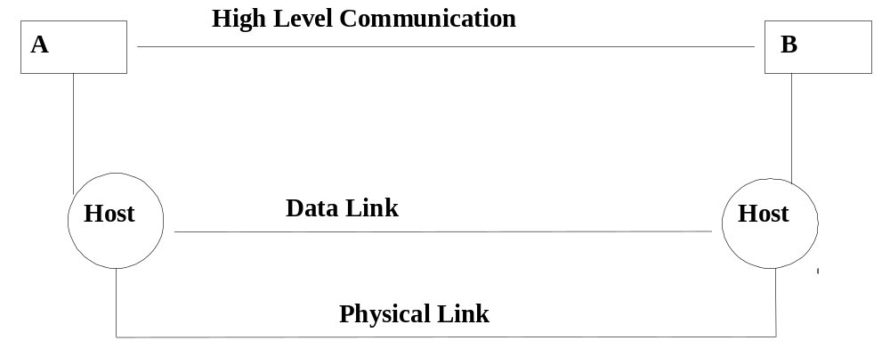
Two Hosts Communicate

Slide 81
Idea for a Protocol
To begin designing a protocol let us make the following unrealistic assumptions :
  a) Simplex data transmission.
  b) Transmitting and receiving hosts are always ready to transmit and receive data.
  c) Processing time is negligible and infinite buffer space is available
  d) Perfect error-free link

Slide 82
Utopia Protocol
Make all assumptions, a, b, c, d.
For this protocol the control header and checksum are unnecessary. The transmitting host simply takes packets from host A (which always has one ready) and pumps them as fast as it can onto the physical link.
The receiver accepts the frames and passes them straight to host B.

Slide 83
Stop-and-Wait
Drop assumption c); processing time ≠ 0; buffer ≠ ∞ ; not simplex
In practice the receiving host needs time to process incoming frames, has only a finite amount of buffer space to queue processed frames i.e. the receiver needs to be able to prevent the sender from flooding it with data faster than it can handle it. Some form of handshaking is required.

Slide 84
Stop-and-Wait (cont.)
In a simple stop-and-wait protocol, the receiver sends an acknowledgement frame back to the sender after delivering the packet to the host. Only after receiving the control frame will the sender fetch and transmit the next packet.

Slide 85
Positive Acknowledgement with Retransmission PAR
Noisy channel simplex protocol: drop some assumptions
  c) [processing time, buffers pace] and
  d) [error free link]
With error prone physical link, frames may be either damaged or lost completely.
However,
    Damaged frames can be detected by the checksum.
    Lost frames will not be acknowledged. Eventually the sender will tire of waiting for an acknowledgement, timeout, and retransmit the frame.

Slide 86
Bright Idea for a Protocol
Same as Stop-and-Wait, except that
  damaged frames are not acknowledged,
  causing a timeout and subsequent retransmission.

Slide 87
Lets Examine a Protocol
Suppose the message “Get Lost Fred” is being sent from A to B, one word per packet

Slide 88
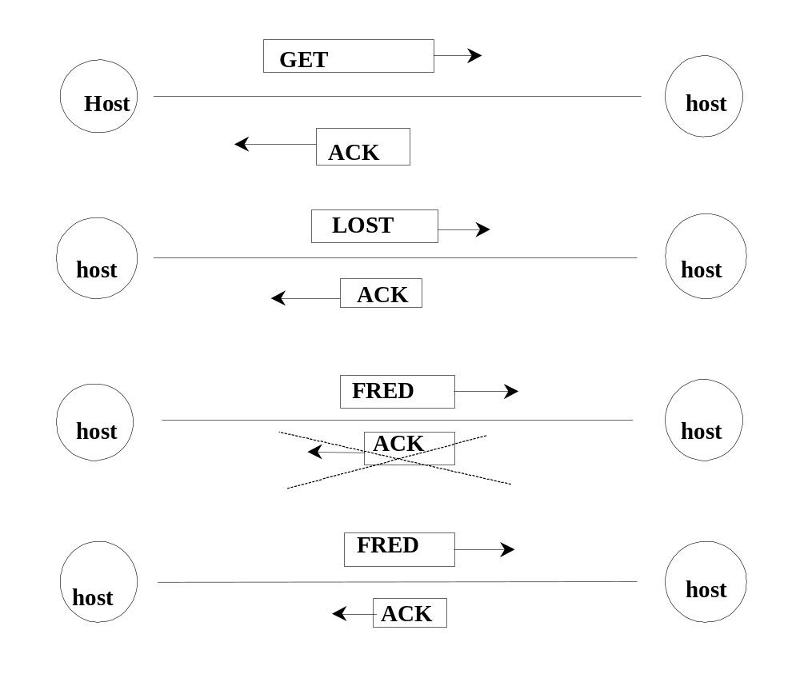

Slide 89
Get Lost Fred
B receives “Get Lost Fred Fred” and the protocol has failed !
Basically what has happened is that the receiver has accepted a duplicate frame.
The solution is to use SEQ, a sequence number in the control header to differentiate between frames and allow duplicates to be discarded.

Slide 90
Get Lost Fred!
As a frame must be acknowledged before the next one is sent, a one-bit sequence number [0,1] is sufficient.
The receiver will expect alternatively numbered frames (0 1 0 1 0 1 ... etc.).
Any frame with the wrong sequence number is rejected as a duplicate
  (but still acknowledged).

Slide 91
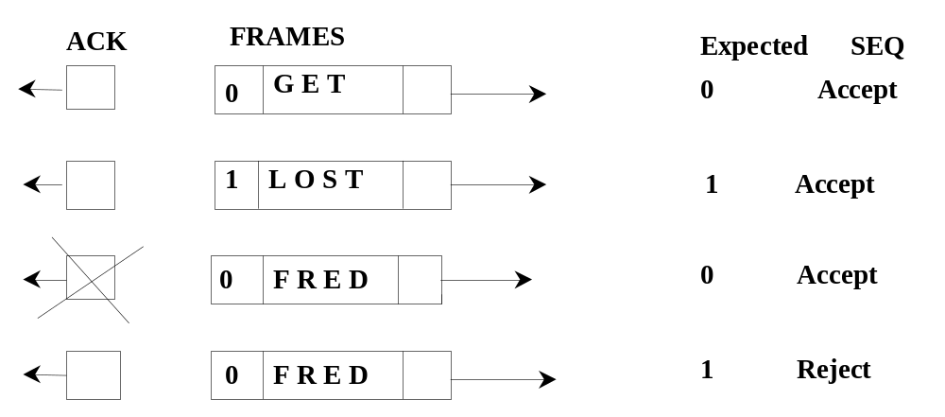
Get Lost Fred

Slide 92
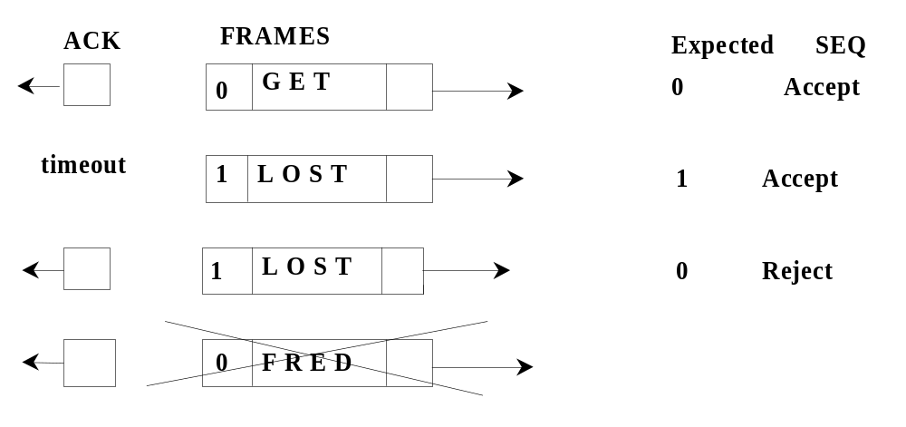
Premature timeouts
The message “Get Lost” is received and the protocol has failed
DOH!

Slide 93
Solution
Include in the ACK field of the acknowledgement control frame the SEQ number of the last frame received without error.
  Then if this number (0 or 1) differs from the transmitted frame, the sender transmits it again.
The resulting PAR simplex protocol will now work in the face of any combination of
  garbled frames,
  lost frames and
  premature timeouts.

Slide 94
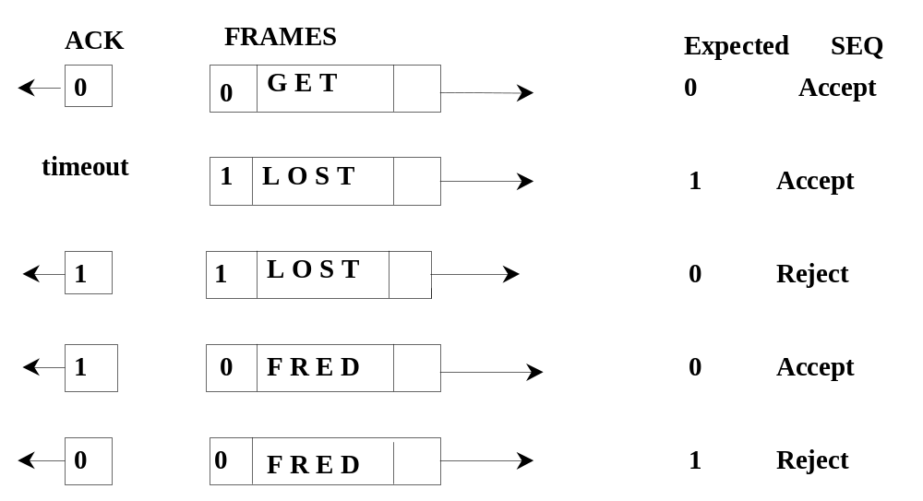
Solution

Slide 95
Summary
After transmitting a frame and starting the timer, Host A waits for a response. There are three possibilities:
  an acknowledgement frame arrives undamaged
  a damaged acknowledgement arrives, or
  the timer goes off.

Slide 96
Summary (cont.)
If a valid ACK comes in, A fetches the next packet and puts it in the buffer
  overwriting the previous packet, and advancing the sequence number.
If a damaged frame arrives or no frame at all arrives,
  neither a buffer nor the sequence number are changed, so that a duplicate can be sent.

Slide 97
Bi-directional PAR
The control header of all frames contains the three fields KIND, SEQ and ACK.
Sending data packets/acknowledgements in both directions is no problem –
  by looking at the KIND bit in the header, the receiver knows which it is dealing with.
However, this would be inefficient.

Slide 98
Bi-directional PAR (2)
Consider an Host B which is about to acknowledge a data frame received from Host A, and also about to send off a data frame to A.
Instead of sending two frames, the acknowledgement can hitch a lift on the data frame, using the ACK field in the header.
This is called piggybacking.

Slide 99
Bi-directional PAR (3)
As we are still making assumption b)
  [Transmitting and receiving hosts always ready to transmit & receive data]
All acknowledgements can be piggybacked. Thus, data packets are bounced back and forth between A and B.
Notes:
  For the protocols considered so far, only one frame is in the wire at any one time.
  The sender needs to keep a copy of each frame in a buffer for possible retransmission until the frame has been successfully acknowledged.

Slide 100
Bi-directional PAR (4)
Assumption b)
  [Transmitting and receiving hosts always ready to transmit & receive data]
Easily dealt with.
  If there is no outgoing data frame, the host will wait a short while to see if one comes along to provide a piggyback.
  If not, a separate acknowledgement frame will be sent.
  It must not wait too long to avoid unnecessary duplicates being sent due to the sender timing-out.

Slide 101
Bi-directional PAR (5)
Up until now, lost and damaged frames have been dealt with in the same way.
  No ACK is sent, leading to timeout and retransmission. The timeout period is usually set quite long in order to avoid complications caused by premature timeout.
  This is inefficient, as while the timeout is expiring, the link is not being used.
A partial solution is NAK, a negative acknowledgement.
  This is sent immediately a damaged frame is received and elicits immediate retransmission.

Slide 102
Bi-directional PAR (6)
The NAK may also be piggybacked.
If the NAK is damaged, no harm is done as the sender will eventually timeout and retransmit as before.
A damaged frame is Nak’d only once.

Slide 103
The Long Haul
Data Transfer Protocols in the Internet

Slide 104
Pipelining
When propagation delay is not negligible, these previous methods are wasteful of bandwidth.
The solution is to ‘fill up the pipe’. However, doing this entails sending off frames before ACKs for previous frames have arrived.

Slide 105
Sliding Window Protocol
Each outbound frame is given a sequence number in the range of 2^{n}-1 using an n-bit field, e.g. if n=1, then range is 0.....1 as in ABP or PAR protocols.
Both sender and receiver keep windows informing them of which frames can be validly sent and which validly received.

Slide 106
Rules
Sender :- The upper edge of sender is advanced when a frame is sent (up to max. window size). The lower edge advanced when ACK received for lowest numbered frame in the window.
Receiver :- Both edges are advanced when the lowest numbered frame in window is correctly received and ACK sent.

Slide 107
Notes
Buffering requirements at both sender and receiver depend on the size of the sending and receiving windows respectively.
Each transmitted frame has its own separate timeout clock.

Slide 108
Notes (cont.)
In these protocols, an acknowledgement for frame N is accepted as acknowledging all transmitted frames numbered up to N (counting circularly).
Thus, if ACK(0) and ACK(1) were both destroyed, but ACK(2) now arrives, it implicitly acknowledges 0 and 1 also.

Slide 109
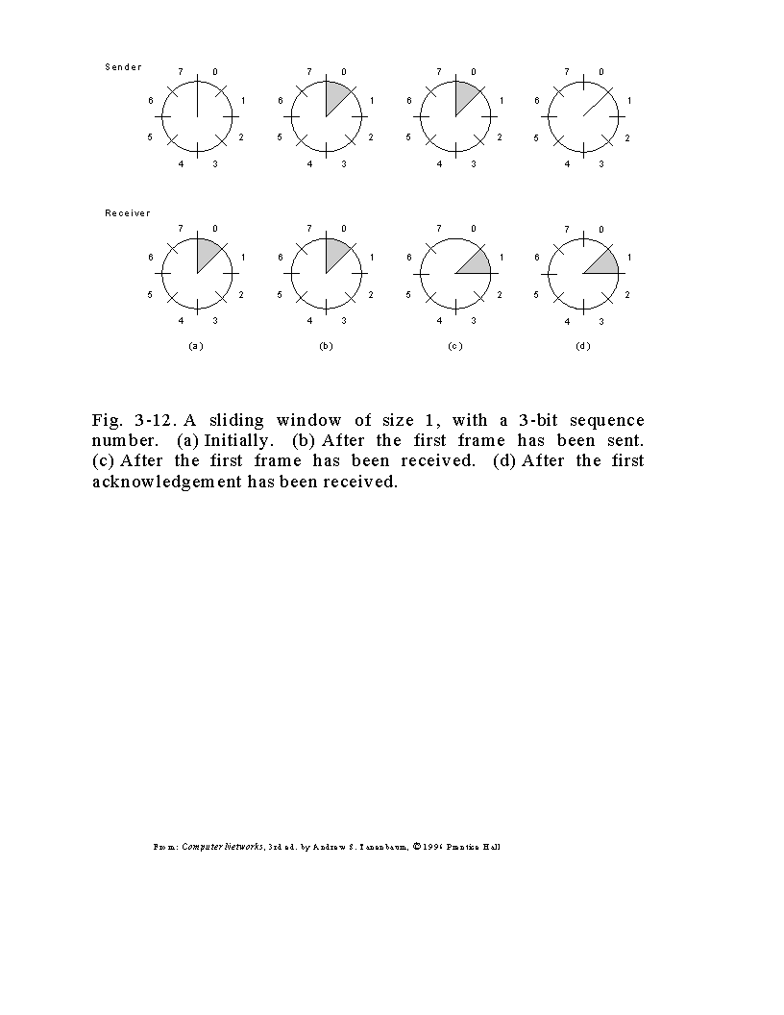

Slide 110
Example Session with Recovery
|--------------Timeout--|
0
1
2
3
4
5
6
7
8
2
3
4
5
9
10
11
12
13
0
1
8
8
8
8
9
10
0
1
E
3
4
5
6
7
8
2
3
4
5
9
10
11
|--------Buffered--------|
ACK#
Pass 2-8 to NW Layer
PAK#

Slide 111
The Stopping Problem
A Data-Link cannot be stopped.
Consider a session termination.
Neither terminal knows that other has sent last packet, the last packet must be ACK’d.
In practice the data-link is dropped after the link is sensed as being dead for a prolonged period.

Slide 112
Switching
Packets must be sent from host to host across a directed network.
Three types of switching are employed.
  Circuit Switching
  Message Switching
  Packet Switching

Slide 113
Circuit Switching
Like old fashioned terrestrial telephone system.
Try to form dedicated physical path from source to destination.
Path remains dedicated until session is terminated.
Not typical operation of bursty comms.

Slide 114
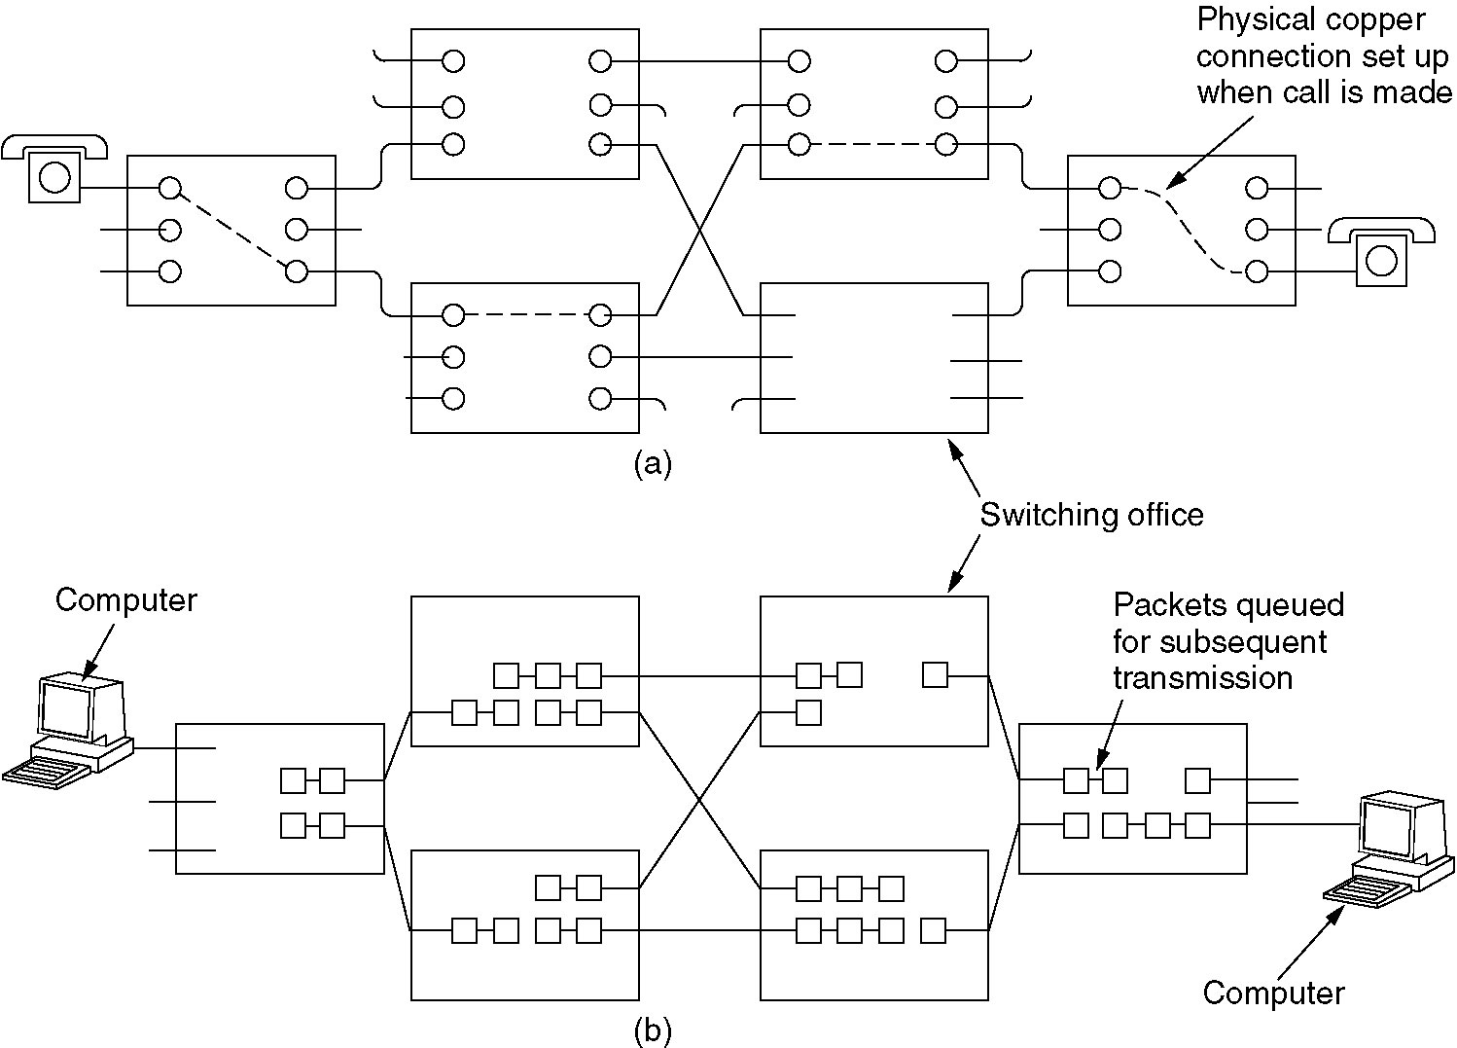
Circuit Switching
(a) Circuit switching.
(b) Packet switching.

Slide 115
Message Switching
No physical path established.
Large bursts of data transmitted from sender to receiver.
Each burst stored and forwarded from host to host throughout network.
No limit to burst size, may encounter memory\buffering and link availability problems.

Slide 116
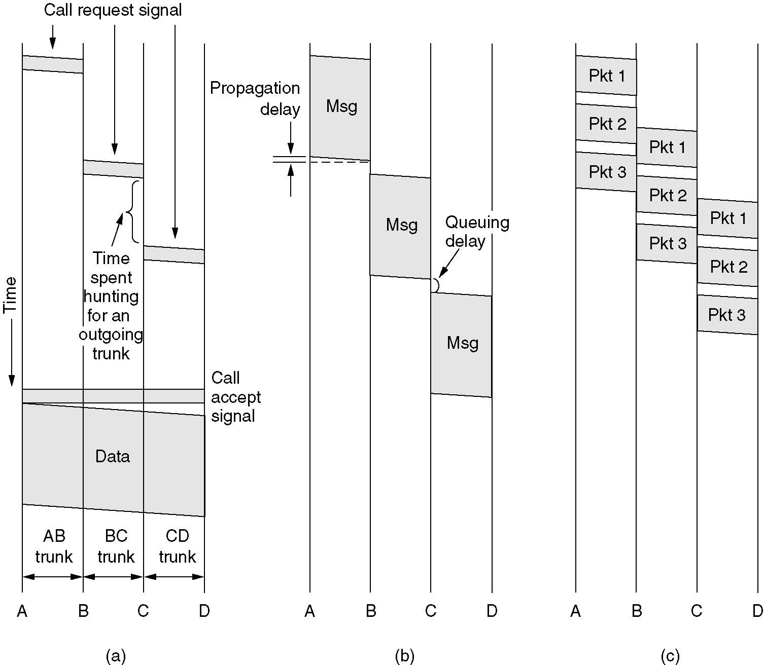
Message Switching
(a) Circuit switching (b) Message switching (c) Packet switching

Slide 117
Packet Switching
Upper limit set on size of blocks to be transmitted.
Ideal for bursty computer communications.
May utilise pipelining to improve throughput.
Large packet size will emulate message switching, small emulates circuit switching.

Slide 118
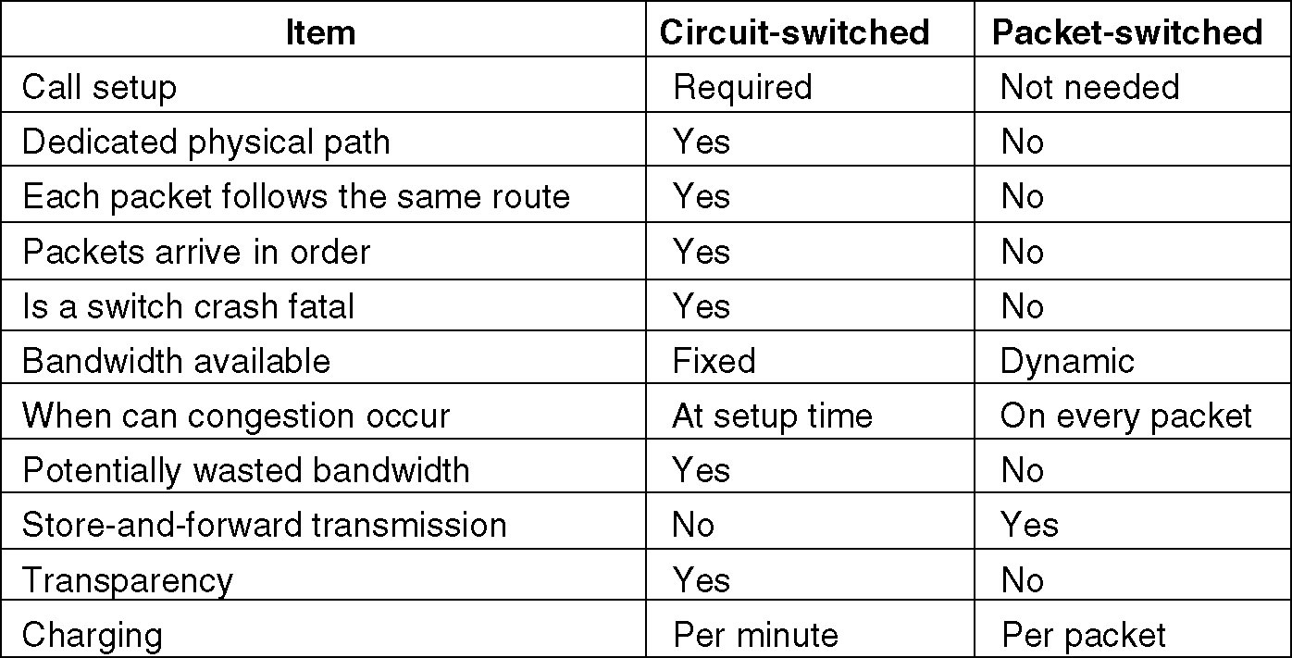
Packet Switching
A comparison of circuit switched and packet-switched networks.

Slide 119
Local Area Networks 802.X

Slide 120
Local Area Networks and 802
IEEE formulated 802 standard for LAN.
ITU (CCITT) adopted 802 as 8802
Common media types are UTP and Co-axial cable.
Topologies may be Ring\ Bus\ Star or Wireless.

Slide 121
Organisation of 802
Layered within the Data-link and Physical layers of OSI protocol stack.
Composed of
  Physical Medium Dependent (PMD) layer.
  Medium Access Control (MAC) layer.
  Logic Link Control (LLC) layer.

Slide 122
802 Standards
802.2 LLC (HDLC based)
802.3 CSMA/CD Bus (Ethernet)
802.4 Token Bus
802.5 Token Ring
802.6 DQDB
802.7 Broadband LAN using Coaxial Cable (disbanded)
802.8 Fiber Optic TAG (disbanded)
802.9 Integrated Services LAN (disbanded)
802.10 Interoperable LAN Security (disbanded)
802.11 WiFi
802.12 demand priority (disbanded)
802.13 Not used (officially)
802.13ah Defines "Copper for the first mile" for Metro Area Networks (proposed)
802.14 Cable modems (disbanded)
802.15 Wireless PAN
802.15.1 Bluetooth certification
802.15.2 coexistance of 802.15 and 802.11
802.15.1 (Bluetooth certification)
802.15.4 (ZigBee certification)
802.16 Broadband Wireless Access (WiMAX certification)
802.16e (Mobile) Broadband Wireless Access
802.16.1 Local Multipoint Distribution Service
802.17 Resilient packet ring
802.18 Radio Regulatory TAG
802.19 Coexistence TAG
802.20 Mobile Broadband Wireless Access
802.21 Media Independent Handoff
802.22 Wireless Regional Area Network

Slide 123
Ethernet Networks
Implementing 802.3

Slide 124
Ethernet
May operate over several cable types.
  10 Base 2 Thin wire coax, bus topology.
  10 Base 5 Thick wire coax, bus topology.
  10 Base T Twisted pair, star topology.
  10 Base F Optical fibre, star topology.
  100BASE-TX fast Ethernet over 100Mbps 802.3u
  1000BASE-T Gbit/s Ethernet over twisted pair
  Today many types of Gbps versions over fiber depending on type of lasers used.

Slide 125
802.3 Frame Format
Preamble
SD
Dest Addr
Src Addr
LD
Data
Pad
CRC
Preamble (7 bytes): Sine wave, clock synch.
SFD (1 byte): 10101011 denoted.
Dest Addr: 6 byte unique 802 address.
Src Address: 6 byte address, 2⁴⁸ possible.
LD: Size of payload.
Data: Payload max 1500 bytes.
Pad: Ensures min size of 64 bytes.
CRC: As discussed previously.

Slide 126
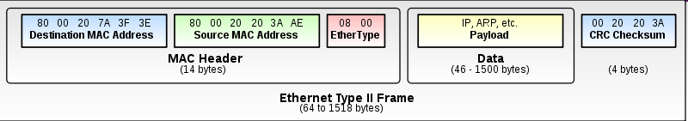
Ethernet II or DIX frames
Defines the 2 octet Type field (LD previously), defining the upper layer protocol encapsulating the frame data
  0x0800 indicates IP V4
  0x0806 is ARP
  0x06DD is IP V6
  Must be greater than 0x0600 (1,536 decimal, > 0x05DC or 1500₁₀ the max payload of Ethernet )

Slide 127
Coexistence of Ethernet & Ethernet II
Both types can exist on the same Ethernet network.
Distinguish V1 and V2 by value in type field
For V2, value in type field must be >=1,536₁₀ or 0x600
  Maximum payload for Ethernet is 0x05DC or 1500₁₀
For V1, value must be <= 1500₁₀ or 0x05DC

Slide 128
802.3 MAC
Carrier Sense Multiple Access with Collision Detection CSMA\CD
Allows multiple stations to share transmission medium.
Senses carrier to see if medium is quiet.
Be able to detect if another station is interfering by continuing to listen to carrier while transmitting.

Slide 129
802.3 MAC Sender Operation
Format frame
Carrier ON ?
Backoff
Set limit
exceeded!
N
Y
Wait interframe gap
Transmit
Limit reached ?
Collision ?
Y
Transmit JAM
Increment attempts
N
Complete

Slide 130
802.3 MAC Receiver Operation
N
Incoming
Signal
Y
Get bit synch
read frame
Y
FCS Ok
Size Ok
Y
N
My Addr
Discard
Y
Pass frame

Slide 131
Truncated
Binary Exponential Backoff
When collision is detected, two stations wish to transmit simultaneously.
Need to prevent continuous collisions between this pair.
Better to have graceful degradation of throughput.

Slide 132
Algorithm
The number of slot times before the N^{th} retransmission attempt is chosen as a uniformly distributed random integer in the range
  0≤R≤2^{K},
  where K = min(N, backoff limit),
  e.g. for a backoff limit of 20, possible ranges of K will be 0..2, 0..4, 0..8, 0..16, 0..20, 0..20, 0..20 for successive attempts at retransmission up to a maximum number of attempts.
The backoff limit of 20 is imposed and prevents the series continuing 8, 16, 32, 64, etc, etc and thus the heuristic is called truncated binary exponential backoff.

Slide 133
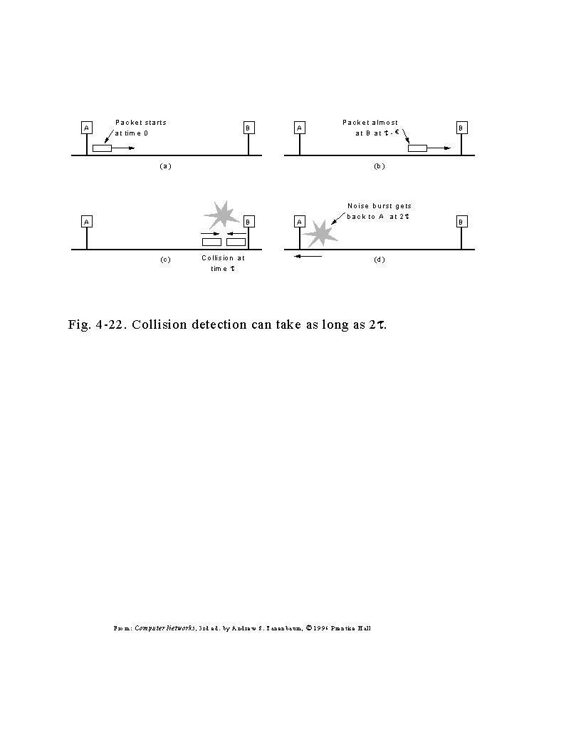

Slide 134
HDLC and 802 LLC
Only best effort datagram service offered by 802 MAC.
LLC offers error controlled, flow controlled data link above 802 MAC.
LLC is common to all 802 standards, based closely on OSI standards.
MAC encapsulates LLC packets.
Based on HDLC.

Slide 135
802.3 Modern Implementations
Most modern implementations of Ethernet use Switched Ethernet.
There are almost no collisions
Packet paths can cross over the switch without colliding, provided each “conversation” has no receivers in common
Improved throughput and better utilisation.

Slide 136
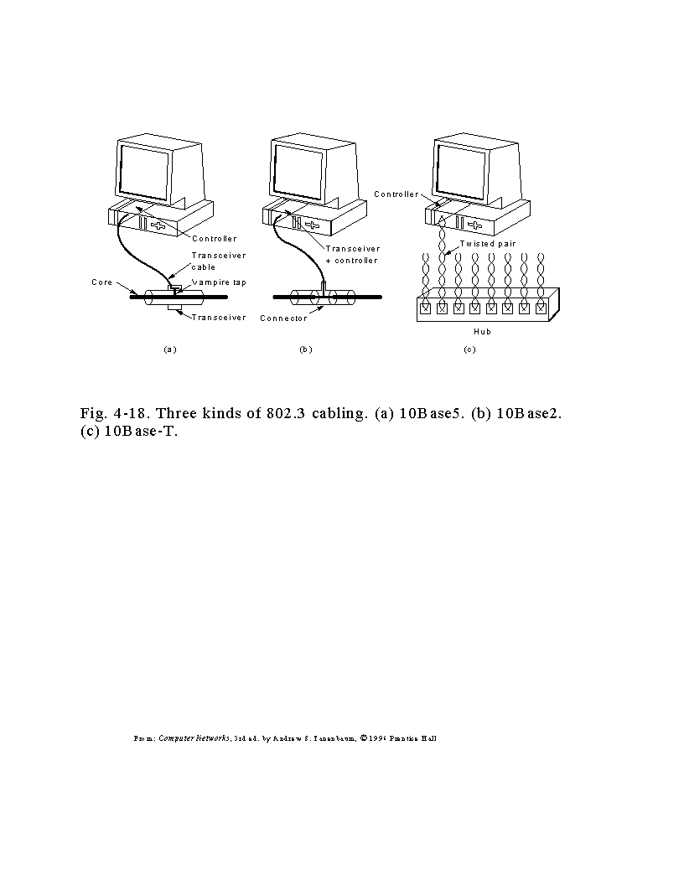

Slide 137
Fast & Gigabit Ethernet

Slide 138
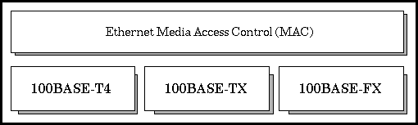
Fast Ethernet (100Mbps)
Factor of 10 reduction in bit-time
No changes to frame format, payload, MAC
Ethernet card negotiates speed at interface

Slide 139
100Base-TX is the one used, all others obsolete
  100 is the speed,
  Base is Baseband
  T4 is twisted pair, 4 pair, TX is 2 twised pair, FX is fiber
Hub reads in a packet and retransmits it on all outgoing lines, except one on which it arrived.
Intelligent switches watch ports and know destination MAC addresses on each port.

Slide 140
Physical Medium
  3 media types, fiber 2-pair UTP, 4 pair UTP
Physical Layer device
  PHY, transceiver, onboard or box with MII cable
MII
  Optional device to allow 10 or 100 Mbps
  Provides flexibility
Data Terminal Equipment DTE
  The Network device itself, the card.

Slide 141
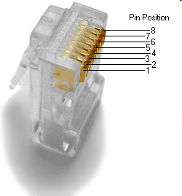
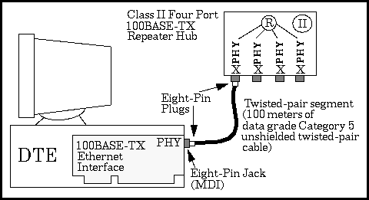
100-Mbps TX Media System

Slide 142
100-Mbps TX Media System
100BASE-TX system operates over two pairs of wires, one pair for receive data signals and the other pair for transmit data signals.
Most popular wiring is unshielded twisted-pair.
  The two wires in each pair of the cable must be twisted together for the entire length of the segment, and kept twisted to within approximately 1/2 inch of any connector or wire termination point

Slide 143
100BASE-TX Components
- Network Medium
- 100BASE-TX Repeaters
- 100BASE-TX Crossover Wiring
- 100BASE-TX Link Integrity Test

Slide 144
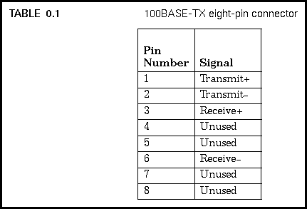
Network Medium
Allows segments of up to 100 meters in length
EIA/TIA standard recommends segment length 90 m between the wire termination equipment in the wiring closet, and the wall plate in the office
  This provides 10 m of cable allowance to accommodate patch cables at each end of the link, signal losses in intermediate wire terminations on the link, etc.

Slide 145
100BASE-TX Repeaters
Two types of repeater: Class I and Class II.
  A Class I repeater allowed to have larger timing delays, and operates by translating line signals on an incoming port to digital form, and then retranslating them to line signals when sending them out on the other ports.
  Possible to repeat signal between media segments that use different signaling techniques, such as 100BASE-TX/FX segments and 100BASE-T4 segments
  Class II repeaters:- restricted to smaller timing delays, and immediately repeats the incoming signal to all other ports without a translation process ;connect only to segment types that use the same signaling technique

Slide 146
100BASE-TX Crossover Wiring
Wiring multiple segments in a building.
  Easier to wire cable connectors "straight through" do crossover wiring inside the repeater hub
For single segment connecting 2 PCs, build special crossover cable
  transmit pins on eight-pin plug at one end wired to receive data pins on eight-pin plug at other end of crossover cable.

Slide 147
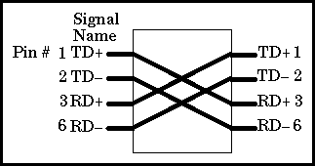

Slide 148
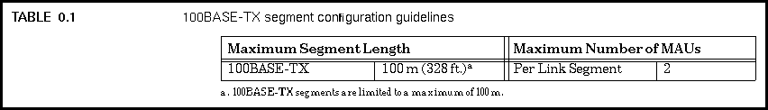
100BASE-TX Configuration
Connect the Ethernet interface in your computer to one end of the link segment, and the other end of the link segment is connected to the hub.
  That way you can attach as many link segments with their associated computers as you have hub ports, and the computers all communicate via the hub.

Slide 149
Gigabit Ethernet
Easy migration to higher speed networks, as opposed to ATM or FDDI (no translation)
Cost is always the issue
Support for new applications and new data demands
Flexibility in network design
MIB (SNMP) management is the same as 802.3

Slide 150
Migration Issues
Frame formats
  Same variable length (64 to 1514 byte) frames
  Allows seamless integration
  No frame translation necessary
  Where to install the upgrade (desktop to switch to backbone) ?

Slide 151
Physical Layer
1000 Base-X based on Fiber Channel Physical Layer (FCPL)
    Proven technology
    1000 Base-SX :- 850 nm laser multimode
    1000 Base-LX :- 1300 nm laser single and multimode laser
    1000 Base-CX copper Shielded Twisted Pair
    table 1
1000 Base-T:- long haul 4 pair category 5 UTP cable (802.3ab task force)

Slide 152
MAC Layer - Carrier Extension
Carrier Extension
  10 times faster than Fast Ethernet, 10m would be max slot size…. Problem
  Slot size of 1512 bytes employed, with pads.
  Carrier Extension allows longer distances
  Transparent to LLC

Slide 153
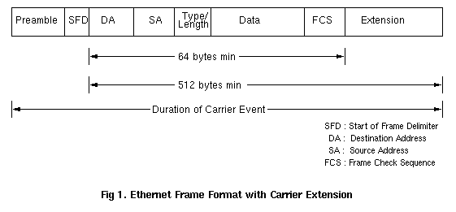
Carrier Extension Diagram

Slide 154
MAC Layer - Packet Bursting
Carrier extension wastes bandwidth, with 448 pad bytes in small packets.
For small packets, throughput only marginally better than fast Ethernet, 802.3X…. Problem !
Solution:- extend the Carrier Extension
  Pad 1st packet to slot time (512 bytes), subsequent packets back to back with minimum inter-packet-gap until burst timer (1500 bytes) expires.

Slide 155
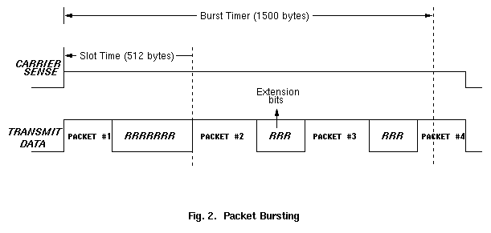
Packet Bursting Diagram

Slide 156
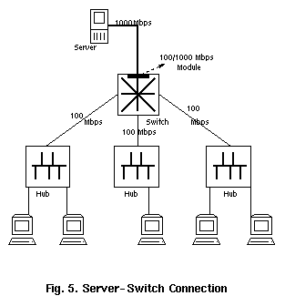
Topologies

Slide 157
Encapsulation and
Protocol Hierarchies
Higher layer entities build packets and provide these as a bit\byte stream to lower layer entities.
Wrapping like Russian Dolls.
Data
Link
Layer
{
MAC
Packet
LLC
LLC
Packet
MAC
LLC
Packet
MAC

Slide 158
Wireless Technologies
PAN
“Personal
Area Network”
LAN
“Local
Area Network”
MAN
“Metropolitan
Area Network”
WAN
“Wide
Area Network”
Bluetooth
802.11b
802.11a
HiperLAN2
802.11
MMDS
LMDS
GSM
GPRS
CDMA
2.5-3 G
Low Data Rates
Short Distances
Notebook/PC to Devices/
Printer/Keyboard/Phone
Higher Data Rates
Medium Distances
Computer-Computer
and to Internet
Higher Data Rates
Med-longer Distances
Fixed, last mile
access
Lower Data Rates
Longer Distances
PDA Devices and
Handhelds to Internet
< 1 Mbps
2 to 54+ Mbps
22+ Mbps
10 to 384 Kbps

Slide 159


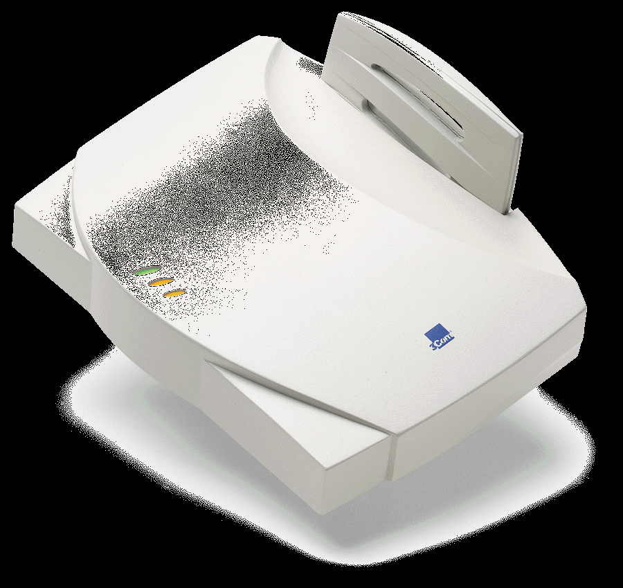

802.11b
WiFi
Switch
Ethernet
PCs
Network
Management
Access
Point

Slide 160
Wireless LANs
The 802.11 Protocol Stack
The 802.11 Physical Layer
The 802.11 MAC Sublayer Protocol
The 802.11 Frame Structure

Slide 161
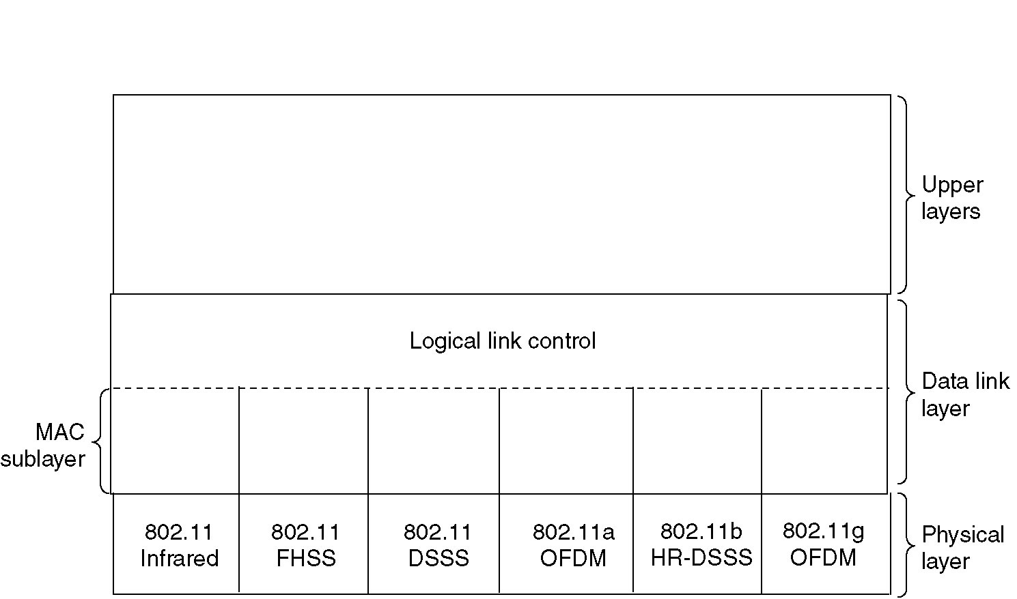
The 802.11 Protocol Stack
Part of the 802.11 protocol stack.

Slide 162
802.11 HR-DSS
High Rate - Direct Sequence Spread Spectrum (HR-DSSS)
Speeds
  1, 2, 5.5, 11 Mbps
Dynamic speed adaptation
Same bandwidth as cordless phones, Bluetooth and microwave ovens
ISM Band

Slide 163
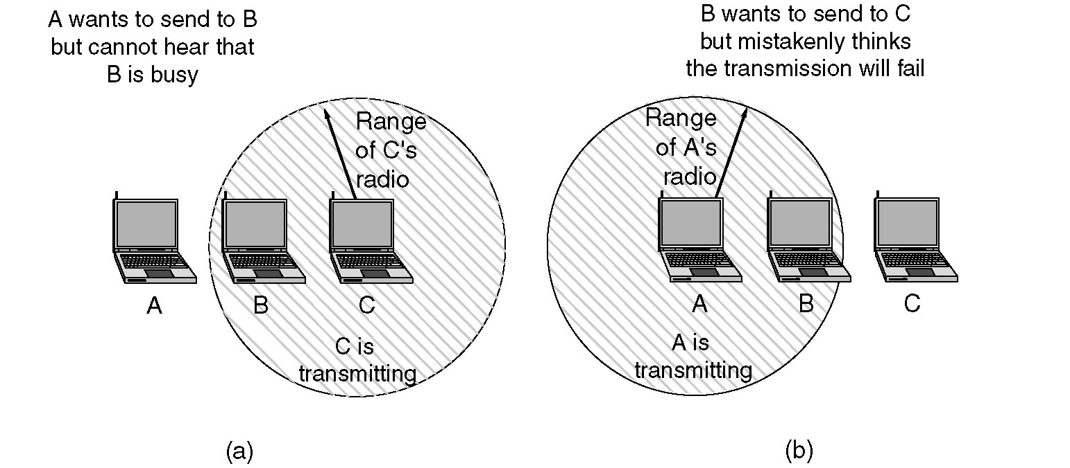
802.11 MAC
(a) The hidden station problem.
(b) The exposed station problem.

Slide 164
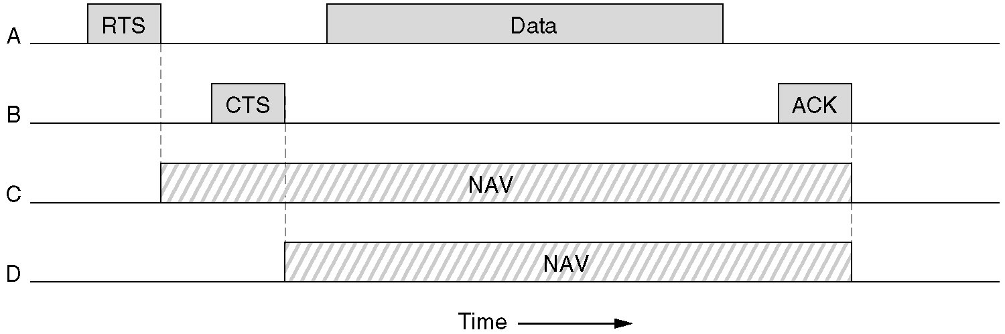
The 802.11 MAC Protocol
CSMA/CA - Collision Avoidance

Slide 165
CSMA/CA
C
A
D
B
Example…
  A wants to send to B, sends RTS
  B says Ok with a CTS frame
  A sends its frame & starts ACK timer.
  B gets frame Ok and sends ACK frame.
  If A’s ACK timer expires, start again

Slide 166
Considering other stations…
  C within range of A… may receive RTS, if so Hush. This is Network Allocation Vector NAV
  D doesn’t hear RTS but hears CTS… assert NAV
  All fine & dandy!
C
A
D
B

Slide 167
But ISM is Noisy!
Probability of 1 bit error is p
Probability of n bit frame arriving uncorrupted is (1-p)^{n}
So, for P = 10⁻⁴, 12144 bit frame has <30% probability of arriving correct.
If 10⁻⁵, roughly 1:9 will be damaged.
If 10⁻⁶, roughly >1:100 will be damaged.
Bigger frames more susceptible to damage!

Slide 168
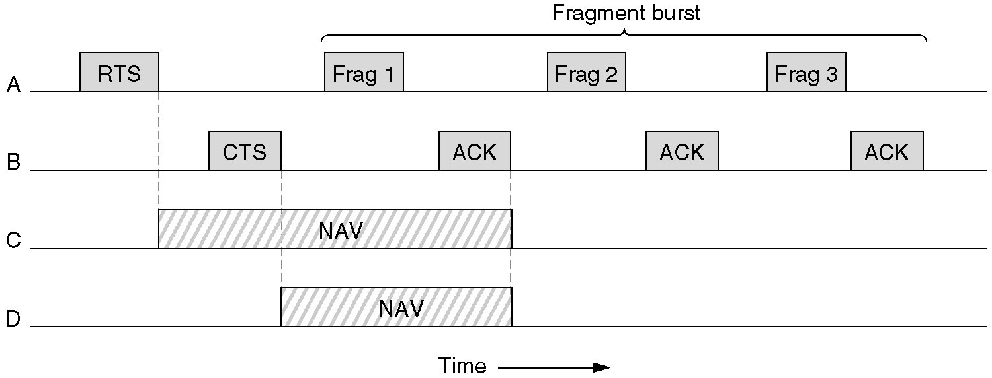
802.11 MAC & Noisy Channel
A fragment burst.

Slide 169
802.11 MAC & Noisy Channel
Fragment frames, use checksums & number
Acknowledge using Stop & Wait
Once channel is acquired (RTS & CTS), send fragment burst, ACK each fragment.
This is what is called Distributed Coordination Function (DCF) Mode

Slide 170
802.11 Point Coordination Function - PCF
Base station polls... central control.
Beacon frame transmitted periodically.
There cannot be any collisions.
Beacon frame contains system parameters.
PCF and DCF may coexist, check Tanenbaum.

Slide 171
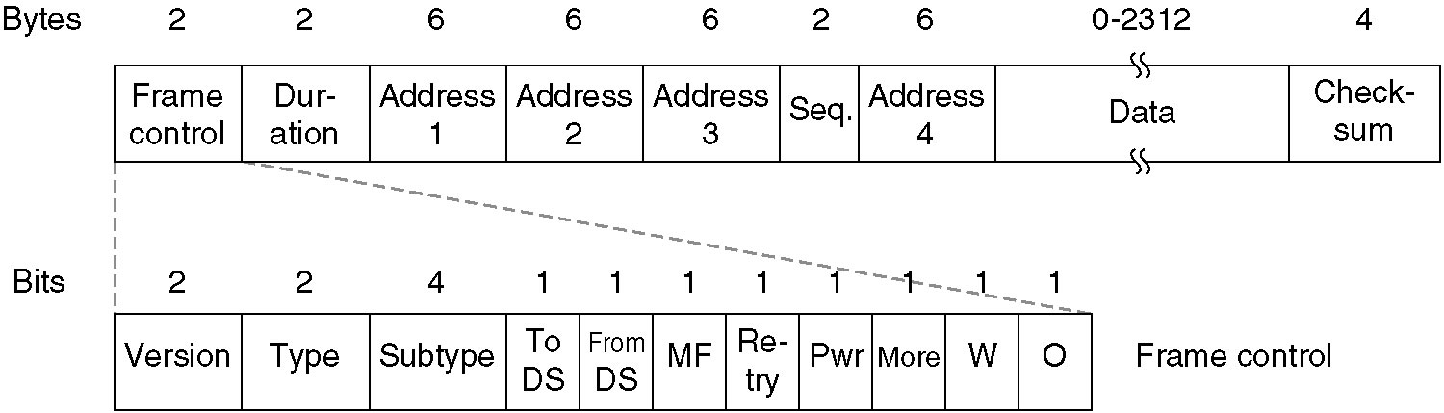
The 802.11 Frame Structure
The 802.11 data frame.

Slide 172
802.11 Frame Structure
Data, Control & Management frames
Control has 11 fields
  protocol version [PCF | DCF]
  Type - [Data | Control | Management]
  Subtype [RTS | CTS]
  To DS and From DS indicate to\from intercell distribution system (e.g. Ethernet)
  MF More Fragments
  Retry - this is a retransmission
  Pwr - power management [go asleep | wake up]
  W - encrypted with WEP
  O - process this frame sequence in order

Slide 173
Duration field says how long frame & acknowledgement will occupy channel.
4 addresses - Source & Dest, also Source & Dest. Base stations for intercell traffic.
Sequence is for fragment numbering, 12 bits for frame, 4 for fragment
Data contains payload, up to 2312 bytes
Checksum is CRC
Mgmt frames operate within single cell
Control frames are RTS, CTS and ACK

Slide 174
802.11 Distribution Services
Association
Disassociation
Reassociation (roaming)
Distribution (wired or wireless)
Integration (protocol translation)

Slide 175
802.11g High Speed Wireless LAN
2.4GHz is still the frequency band with 54Mbps
Compulsory…
  Orthogonal Frequency Division Multiplexing (OFDM ) used for rates > 20Mbps.
  Complementary Code Keying (CCK) required for backward compatability.
Optional
  CCK\OFDM Hybrid Header\Payload
  PBCC Hybrid Header\Payload (Texas Instruments)

Slide 176
802.11g Packet
Preambles & Payloads
Preamble/Header
Payload
Preamble warns of forthcoming packet
Header contains length of packet.
Payloads vary from 64Byte to 1500Byte.
Generally CCK used to transmit header and payload, usually!

Slide 177
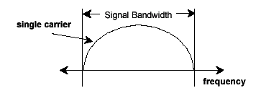

CCK & OFDM
Max. 11Mbps
Max. 54Mbps

Slide 178
WiFi Interoperability
CSMA\CA will be used again.
RTS\CTS will be used
Headers may be transmitter using CCK and payloads may use OFDM
CCK
CCK
CCK
OFDM
OFDM
OFDM

Slide 179
802.11g Security
Wired Equivalent Privacy (WEP)
  Garbage
Service Set Identifier (SSID)
  Disable broadcasts
WiFi Protected Access (WPA)
  Stronger than WEP
MAC Address Authentication
802.1x Network Authentication
  EAP

Slide 180

Comparing Wireless Technologies
{
Security? - RUBBISH !

Slide 181
Links
http://www.xilinx.com/esp/Bluetooth/tutorials/bt_overview.htm
http://www.palowireless.com/bluearticles/intro.asp
Bluetooth Application Developer’s Guide, Edited by Jennifer Bray (Syngress, published 15/12/01)
Bluetooth, Connect Without Cables, Jennifer Bray and Charles Sturman (Prentice Hall) [more hardware focused]
Wireless ad hoc networking - the art of networking without a network. Magnus Frodigh, Per Johansson and Peter Larsson, Ericsson Review No. 4, 2000
Infrastructure for Distributed Applications in Ad Hoc Networks of Small Mobile Wireless Devices (the Anhinga project). Alan Kaminski, Rochester Institute of Technology, May 2001.

Slide 182

Books
Bluetooth: Connect without cables. Bray & Sturman ISBN 0-13-089840-6

Slide 183
The Internet
Issues to be Addressed

Slide 184
Internetworking
TCP/IP is the de-facto internet standard.
Major issues to be addressed in Internetworking are…
  Service type.
  Addressing
  Routing
  QOS
  Max. packet size
  Flow & congestion control
  Error reporting

Slide 185
Service Type
Connection oriented TCP
  Provides reliable error free transport.
  Utilises sliding window protocol.
Connectionless UDP
  Provides best effort datagram delivery.
  Unreliable, packets may be discarded, not acknowledged.

Slide 186
Addressing
How do we address processes running on hosts ?
How do we ensure unique addresses ?
How do we map LAN addresses to TCP/IP addresses ?
How do we interpret addresses ?
How do we know where to send packets, i.e. route packets ?

Slide 187
Routing
Issues include …
  How does host determine address of router attached to its network.
  How does router determine the NPA addresses of hosts attached to its network.
  How does host select a particular router when sending a packet.
  How does router determine addresses of other routers attached to the same network
  How does router select another router to which to send packets given destination host address.

Slide 188
Quality of Service
Issues include…
  Transit delay expected when delivering packets to destination.
  Security and privacy required.
  Cost of delivery.
  Probability of error.
  Priority of transfer.

Slide 189
Maximum Packet Size
Prevailing conditions may determine size.
  High bit error-rates: smaller packets better.
  Large transit delay: large queuing delays at each intermediate router, reduces efficiency.
  Buffer requirements at routers may dictate that it is easier to store smaller than larger packets..
  Processing overheads used in processing large numbers of small packets are larger than processing smaller numbers of larger packets.

Slide 190
Introduction to TCP/IP

Slide 191
TCP/IP
Four layer Architecture
Developed in 1960’s
Open System
Not just one protocol, whole family.
Many programming interfaces available.
Standardised protocol set.

Slide 192
IP Addressing Scheme
Need capability of mapping addresses of one type onto another.
LAN address, Network Point of Attachment NPA, must be mapped onto an IP address.
NPA formats differ from one LAN standard to another.
IP addresses are homogenous within single IP version.

Slide 193
IP Address Format
7 bits
24 bits
Class A
0
netid
hostid
14 bits
16 bits
Class B
10
netid
hostid
21 bits
8 bits
Class C
110
netid
hostid
28 bits
Class D
1110
Multicast group ID

Slide 194
IP Address Format (cont.)
Different size networks may use different address classes, defined by the first few bits in the address. 0 for Class A, 10 for Class B, 110 for Class C, etc. etc.
Networks with large numbers of hosts may use Class A, while Class C may have many subnets with a small number of attached hosts.

Slide 195
IP Address Notation
A decimal dot notation is used to break down the IP address.
Example
  10001000 11001110 00001011 00000110
  gives the address 136.206.11.6 aka boole !
  Note that this is a Class B address (first zero in second position) and the subnet is defined with 14 bits, the host address with 16 bits.

Slide 196
IP Allocations
A central authority has responsibility for allocation of IP addresses. They are the network Information centre, or NIC.

Slide 197
TCP/IP Encapsulation
user
Data
Appl
Hdr
user
Data
Application
TCP
header
Application Data
TCP
IP
header
TCP
header
Application Data
IP
Ethernet
header
IP
header
TCP
header
Application Data
Ethernet
trailer
802.3

Slide 198
IP Packet Header
4bit ver.
4bit hdr L
8bit TOS
16-bit total length (bytes)
16-bit identification
3 bit flags
13 bit frag. offset
8-bit TTL
8-bit protocol
16-bit header checksum
32-bit source IP address
32-bit destination IP address
Options
Data

Slide 199
IP Header Description
Version: Currently V 4.
Header Length:Specifies length of header as some fields are optional.
Type of Service:This is the same as the QOS mentioned previously.
Total length:Specifies the length of the datagram.

Slide 200
Identification: Used to identify a set of datagrams which were formed from a single user message, but which got fragmented while traversing possibly several networks.
D bit:Indicates that routers should not fragment a datagram i.e. Don’t fragment bit.
M bit:Indicates that there are more fragments to follow in later datagrams.
Fragment offset:Where this fragments fits into the original fragmented datagram.

Slide 201
Time to live: Datagram loses a life (or some time to live) on each hop across the internet. Datagram destroyed when time\lives run out. Prevents Datagrams from wandering endlessly.
Header Checksum: Checks header only.
IP addresses (Source, Destination): As described previously.

Slide 202
IP Routing
Central function of IP is routing along with fragmentation and re-assembly of data across an internet.
Routing information organised in a hierarchy. With hosts and gateways involved.
ARP address resolution protocol maps IP to Ethernet addresses, an Interior Gateway Protocol (IGP)

Slide 203
Exterior Gateway Protocol (EGP) knows about other routers on the internet and can route from network to network.
Distance Vector and Link State routing are most popular, Link State is superior.
Subnet addressing may be performed on a group of related networks (owned by one organisation).
More on Routing later…

Slide 204
Special IP Addresses
Some addresses are reserved for special use.
IP address composed of all 0 means this host.
Network part all 0, Host part not, host on this network.
All 1s broadcast on LAN
Host part 127.0.0.x is Loopback, useful for debugging.
192.168.0.0 and 10.0.0.0 are reserved by IANA and are private addresses
172.16.0.0 up to 173.31.255.255 are reserved /12 or 16 class B addresses also reserved.

Slide 205
Creating Subnets
Address space
  [network#, host#]
  [network#, subnet#, host#]
Subnet mask used to find the host part of IP address and distinguish it from the NW part.
Class | Format | Default subnet mask
A | nw.node.node.node | 255.0.0.0
B | nw.nw.node.node | 255.255.0.0
C | nw.nw.nw.node | 255.255.255.0

Slide 206
Subnetting – Why?
Reduces Network traffic
  Routers create smaller broadcast domains, more smaller domains limits the span of a broadcast.
Optimizes NW performance
  Less traffic, things run faster.
Simplifies management
  Easier to do fault analysis on a smaller self-contained NW than with a single huge NW
Facilitates spanning of large geographical distances
  Single large NW over large distance incurs big overhead of resources. Smaller NWs which keep much traffic local will incur less overhead over the long haul.

Slide 207
CIDR
Classless Inter Domain Routing -
Give the IP address space some breathing room!
Basic idea: allocate the remaining IP addresses in variable-size blocks without regard to classes
  original name: Supernetting, the opposite of Subnetting (sortof)
A site needing 2000 addresses receives a block of 2408 addresses i.e., 8 contiguous class C networks. If need 8000 hosts, then allocate a block of 8192 addresses, i.e., 32 contiguous class C networks.

Slide 208
Variable Length Subnet Masks
Only works with routing protocols which support CIDR
Different masks on each router interface. Small number of bits for routers so they have few hosts, few routers. Keep big numbers for LANs
Match required number of hosts to appropriate mask on each interface.
Requires careful design so that blocks do not overlap
Routes may be summarised, providing a hierarchy.

Slide 209
Transmission Control Protocol
OSI Transport Layer

Slide 210
TCP Services
Provides connection-oriented, reliable, byte stream service.
Segments passed to IP for routing, timer attached for each segment.
Sliding window protocol utilised with go-back-n or selective-repeat for retransmission.
All TCP segments acknowledged.

Slide 211
TCP segments may arrive out of order, sliding window will sort order.
TCP segments may be duplicated, duplicated are discarded.
TCP provides flow control, no process\host will be swamped, helps avoid congestion.
TCP utilised by many internet applications such as Telnet, Rlogin, FTP, E-mail, WWW Browsers.

Slide 212
TCP Segment Header
16-bit source port number
16-bit destination port number
32-bit sequence number
32-bit acknowledgement number
4bit hdr
length
reserved
u
r
g
A
C
K
P
S
H
R
S
T
S
Y
N
F
I
N
16-bit window size
16-bit TCP checksum
16-bit urgent pointer
Options (if any)
Data (if any)

Slide 213
TCP Header Description
Source Port and Destination Port identify transport end-points of connection.
Sequence Number and Acknowledgement Number perform usual functions, Ack numbers next byte expected.
TCP Header Length indicates number of 32 bit words in header. Length varies because of options.
Not used. No bug fixes required !

Slide 214
Six one bit flags…
  URGent pointer in use, used for indicating interrupts and offset from seq no. to urgent data.
  ACK bit used to indicate piggybacked acknowledgement.
  PSH requests that receiver does not buffer but to deliver.
  RST is reset connection, means problems !
  SYN used in conjunction with ACK to request connection.
  FIN release connection

Slide 215
Window size used for variable-sized sliding window. Size of zero indicates a choke packet.
Checksum checks header.
Options field for things like specification of maximum TCP payload. Negotiated at startup lowest bid wins.
A selective repeat instead of go-back-n sliding window protocol may be specified as an option.

Slide 216
TCP Addressing
TCP uses notion of Port Number to access transport endpoint on a single host. Many Ports may be in use simultaneously.
Combination of IP address and port number uniquely identifies a port for process running on a particular machine.
Process may even have several ports open.

Slide 217
Three Way Handshake
Socket,
Bind,
Listen
Accept(blocks)
Socket
Connect(blocks)
(active open)
SYN J
SYN K, ack J+1
Connect returns
Ack K+1
Accept returns
Read(blocks

Slide 218
TCP Connection Termination
If application calls close first, this is an active close.
Sends FIN segment, meaning finished sending data.
Server performs passive close.
Clients FIN is ack’ed and sent to application as EOF, after any queued data to receive.
When application receives its EOF, it will close its socket. TCP sends FIN.
The server on receiving final FIN acks that FIN.

Slide 219
Close
(active close)
FIN M
(passive close)
read returns 0
close
ack M+1
FIN N
ack N+1

Slide 220
TCP Connection & The Packets
A complete TCP connection involves many packet exchanges.
  Connection establishment
  Data transfer
  Connection termination
  TCP states are also shown as client and server enter them.

Slide 221
Client
Server
socket, bind, listen
LISTEN(passive open)
accept(blocks)
SYN_RCVD
ESTABLISHED
accept returns
read(blocks)
read returns
<server process request>
write
read(blocks)
CLOSE_WAIT(passive close)
read returns 0
close
LAST_ACK
CLOSED
Socket
Connect(blocks)
(active open) SYN_SENT
ESTABLISHED
Connection returns
<client forms request>
Write
Read(blocks)
Read returns
Close
(active close) FIN_WAIT_1
FIN_WAIT_2
TIME_WAIT
SYN J
SYN K, ack J+1
ack K+1
Data (request)
Data reply
Ack of request
ack of reply
FIN M
ack M+1
FIN N
ack N+1

Slide 222
The interactions
Once connection established, clients forms request for server.
Server processes request and replies with piggybacked ack.
Termination by client (active close)
  Waits 2MSL (Maximum Segment Lifetime) to deal with lost or wandering IP packets.

Slide 223
UDP
The User Datagram Protocol. Its characteristics are:-
  Packet-oriented
  Connectionless
  Unreliable
UDP adds almost nothing to the IP network layer over which it is transported. It just introduces the concept of a port (a concept it shares with TCP as we will soon see).
A port is an abstraction which can be regarded as a transport-layer address (remember the role of the transport layer) which uniquely identifies a particular process (or endpoint) on the destination node

Slide 224

UDP
The UDP header is very brief...
The checksum is sometimes ignored…
  Most datalink layer protocols include some form of error-checking (e.g. Ethernet CRC)
  For some data types (e.g. VoIP), timely but (slightly) corrupt data is better than late but accurate data

Slide 225
UDP
Services listen on well-known ports.
  DNS on UDP port 53
  Syslog on 514
  SIP on 5060
These are administered by IANA (the Internet Assigned Numbers Authority) and the definitive list is maintained at http://www.iana.org/assignments/port-numbers
Another good place to look these up is the /etc/services file on a Linux box or the %WinDir%\system32\drivers\etc\services file on Windows

Slide 226
UDP
When a client wants to communicate with a UDP server, it starts by allocating a randomly-chosen UDP port > 1024. This will be the source UDP port.
It will then transmit to the server on the destination port (e.g. one of the well-known ports mentioned on the previous slide).
The server will reply with a UDP packet from the well-known port back to the port the client transmitted the request from
The combination of (source IP address, source UDP port, destination IP address, destination UDP port) uniquely identifies this “session” (although the concept of a session is artificial with the connectionless UDP protocol)

Slide 227
UDP
When the client transmits its packet to the server, it has no way to know if there actually is a service (i.e. process) listening on this port at the destination. If not, the network (IP) layer on the server will return an ICMP “Port Unreachable” message

Slide 228

UDP

Slide 229
ICMP, ARP, DNS and DHCP
Keeping everything in working order by using client protocols from the TCP\IP family

Slide 230
ICMP, ARP, DNS and DHCP
ICMP is the Internet Control Message Protocol which is and “internal” protocol IP uses for sending control and status information. ICMP message types include unreachable, source quench, time exceeded, redirect, echo request & reply
ARP is the address resolution protocol. It it a protocol by which IP addresses are mapped to corresponding MAC addresses in a LAN environment
DNS or Domain Name Server translates addresses like www.dcu.ie into corresponding IP addresses
DHCP Dynamic Host Configuration Protocol leases out IP addresses to machines temporarilly attached to a LAN, like your laptops in DCU

Slide 231
Address Resolution Protocol
ARP

Slide 232

ARP
The Internet is based on IP addresses
Data link protocols (Ethernet, FDDI, ATM) may have different (MAC) addresses
The ARP and RARP protocols perform the translation between IP addresses and MAC layer addresses

Slide 233
Address Resolution Protocol
ARP performs a lookup service that finds a MAC address for a given IP address.
A system that needs a MAC address for a given IP address broadcasts a query which contains the IP address to all systems on the network.
If a system receives the query and the IP address in the message matches its own IP address, it sends its MAC address to the sender of the query.
IP and MAC addresses are the usual but not the only formats available to ARP

Slide 234
Operation of ARP
Each host maintains a table, the ARP cache, temporarily stores the results from previous address resolutions.
ARP Request is broadcast to all systems on the network.
In Ethernet, a frame is broadcast when the destination MAC address is set to broadcast address ff:ff:ff:ff:ff:ff.
A broadcast frame is received and processed by all hosts.
If a system receives the ARP request and the IP address in the message matches its own IP address, it issues an ARP Reply message to the sender of the query.

Slide 235
Gratuitous ARP
Every host that sees an ARP Request verifies its ARP cache checking for the sender IP of the ARP Request.
If such an entry exists, it updates the MAC address with the address in the ARP Request.
Since ARP Requests are broadcast message, these updates are made by all systems each time an ARP Request is transmitted on the network.
This feature is exploited in a concept that is called gratuitous ARP.

Slide 236
ARP Vulnerabilities
ARP may be used to redirect traffic intended for a certain IP address to another on the NW
Broadcast ARP replies with invalid MAC addresses insert incorrect entries into ARP caches.
  Poison ARP attack

Slide 237


ARP Packet Formats
* Depends on length of Datalink and Network layer addresses

Slide 238
Note: ARP Packet Formats - I
Ethernet carries ARP, with type set to 0x8060
ARP message, in IP and Ethernet scenario is 28 bytes (48 bit MAC + 32 bit IP)
Hardware type is datalink protocol
  Ethernet = 0x0001, 802 = 0x0006
Protocol type field is the network layer used
  IP = 0x8000
Operation code is 0x0001 for ARP requests and 0x0002 for ARP replies
Hardware address length and Protocol address length specify length of addresses (MAC-6, IP-4).

Slide 239
Note: ARP Packet Formats - II
The next four fields contain the hardware address and the network address of the sender and the intended receiver of the ARP packet.
The former is referred to as the source and the latter is referred to as the target.

Slide 240

An ARP, the Router, and My PC

Slide 241

Arp Cache

Slide 242


Sample NW and test
A
00:06:58:e3:4d:1d
192.168.0.105
B
00:07:e9:53:87:d9
192.168.0.100
Hub \ DHCP Server
00:06:25:8d:be:1d
192.168.0.1

Slide 243
arp Tool
Issue arp command
Tells you how to use it
Issue arp –a it dumps its cache
>arp –a
Interface 192.168.0.105 --- 0x10004
Internet Address Physical Address Type
192.168.0.1 00-06-25-8d-be-1d dynamic
192.168.0.100 00:07:e9:53:87:d9 dynamic

Slide 244
Make Data
Issue ping –n 1 192.168.0.100 from A
Machine A sends a request message to B
Check out arp.cap for results
Note the source and dstination addreses used in this trace.

Slide 245
Make More data
Now delete the arp cache with
  arp –d 192.168.0.100
Do second ping –n 1 192.168.0.100
A issues arp request in packet 3 (broadcast addr)
B replies in packet 4, replenishing arp cache of A and allowing it to issue a ping request in packet 5
Finally issue third
  ping –n 1 192.168.0.100
Results are in packet 7 and 8

Slide 246


Slide 247
ARP Exercise
Replicate the previous experiments on machines in the lab (ground floor is equipped with Wireshark).
Use arp and ipconfig to find out the IP and MAC addresses of the machines, clear the caches etc as done in the experiments. You will need 2 machines to do this.
Something new:
  Check out the CRC calculations in the frames and account for any discrepencies.
Use appropriate filters in Wireshark to limit captured traffic to that of interest for the experiment.
Save your traces in Wireshark to a file.

Slide 248
Proxy ARP
Proxy ARP is a configuration option for IP routers, where an IP router responds to ARP
Request that arrive from one of its connected networks for a host that is on another of its connected networks.
Without Proxy ARP enabled, an ARP Request for a host on a different network is unsuccessful, since routers do not forward ARP packets to another network.

Slide 249
RARP
Given an Ethernet address, what is the IP?
RFC 903 – RARP sovves this problem – Broadcasts MAC gets back IP from RARP server.
Broadcast address stays within 1 domain (router)
Needs to get further or else have 1 RARP server in each MAC broadcast domain.
Solution – use BOOTP

Slide 250
BOOTP
RFCs 951, 1048, 1084
Use UDP messages, broadcasts forwarded over routers!
Also provides
  info on IP of file server with disk image
  IP address of default router
  Subnet mask
Problem: Manual config of IP – MAC, gives rise to errors.

Slide 251
Under the Hood: HTTP
Please view the podcast on Wireshark in association with this lecture

Slide 252
Introduction
HyperText Transfer Protocol
Application Layer
  Program to Program communications
  Underlying networks are abstracted
Client \ server paradigm
  Typically Web browser like Firefox the client, Apache Webserver the server.

Slide 253
URL
Universal Resource Locator
  http://moodle.dcu.ie/
  http is Hypertext Transfer protocol
  moodle is machine name on a domain
  dcu.ie is the domain name
  www.computing.dcu.ie
  www.computing is the webserver for the school

Slide 254
HTML
Hypertext Markup Language
Transfers hypertext (text with URLs embedded)
Also transfers images, music, emails output from programs etc.
RFC 2616 is the standard for HTTP 1.1

Slide 255


Request\Response
HTTP works on a request\response mechanism
1: HTTP Request
Internet
Web Server
2: HTTP Response
Web browser on Client

Slide 256
RFC 2616: HTTP 1.1
Standards document for HTTP
Describes
  formats for all legal HTTP requests and responses
  Formats of URLs
  Controls for caching web pages
  Persistence of connections
Allows independent developers to develop their own web servers and clients and have them inter- operable

Slide 257
Example: Configuration
Modem\Router
Internet
Desktop PC
Web Servers

Slide 258

Setup I
Clear web browser cache
  In Firefox, under menu <Tools><Options>
    Advanced tab
  Click Clear Now
Now when you ask for a website, you generate new traffic and do not just retrieve something saved earlier.

Slide 259

Setup II
Clear the DNS Cache
  DNS remembers the IP address for a corresponding website already visited.
In a CMD prompt type …
Ipconfig /flushdns
Now all buffers are clear and it is as though we have a brand new connection

Slide 260
Experiment
Contact Google.com
See the file on Moodle
First 2 packets resolve google.com into an IP address using application layer protocol called Domain Name System, DNS
Now a TCP connection is established, packets 3-5.
Packet 6 sends “GET / HTTP1.1\r\n”

Slide 261


Slide 262


Slide 263
HTTP Get Request
“GET / HTTP1.1\r\n”
GET something, a file called “/” (default)
\r is carriage return and \n is a line feed
  Old typewriter terminology, used to separate one header from the next, each successive header has one, check it out.

Slide 264
The Headers I
The name www.google.com\r\n specifies which webserver is being contacted.
  IP addressed machines may support several web-servers
User-agent describes web browser and client machine making the request (this setup is quite old, a Mozilla browswe, forerunner of Firefox and the Windows NT operating system)

Slide 265
The Headers II
Accept headers
  Server may support several languages, encodings, character sets, these tell server which is preferred.
  Keep alive and connection headers tell about the TCP connection being used, whether connection should be kept open and for how long.
  Most connections are persistent, allowing multiole requests from same client to server. This improves performance greatly of HTTP 1.1 over HTTP 1.0

Slide 266
HTTP Response
Packet 7 the response…
  First HTTP 1.1 is fine with the server
Headers…
  Cache-control: whether to store copies for future reference. Private here means that this is a specially generated and can be cashed by the user, but not by a group of users on a “shared proxy cache”
  Lists the types of content and encodings it can accept, text/html and gzip (compressed)
  GWS identifies itself as google’s own webserver
  Content length is 1216 long and we get the date.

Slide 267
Multiple GET requests per URL
Only 1 GET request in packet 8
Second request generated by the HTML source sent back for processing at the client.
  GET /images.logo.gif HTTP/1.1\r\n
It asks for the Google logo
Several requests may be daisy-chained like this
Multiple requests are very sophisticated now

Slide 268
GNU
GNU is a famous open source and licensing organisation on the web
From packet 21 a similar interaction can be seen sorting out where it is
Packet 26 onwards contains the interactions with it.

Slide 269
Following TCP Stream
Wireshark allows us to follow particular interactions.
Looking at the full interaction for Google
  Select <Analyze> menu, and <Follow TCP Stream> from the menu. You will see every interaction between your client and the server. Each are coloured differently.
A filter has been automatically entered for you
  (ip.addr eq 192.168.0.101 and ip.addr eq 216.239.37.99) and (tcp.port eq 3840 and tcp.port eq 80)
  This is very useful

Slide 270
Multiple TCP Streams
Packets 35, 41 and 42 open second TCP connection, same IP address as the first, same port (80), but local client port is different, 3842 instead of 3841.
  This gives rise to a second, parallel connection which speeds up transfer.

Slide 271
Questions
Isolate the requests sent by the browser to the server
Visit Google.com
  <View ><Page Source>
  Copy it into a file called test.html using Notepad application
  Open a web browser and drag the file into the browser
  What website do you see and what is missing and why?
  Write a colour filter to highlight all of the HTTP requests in the trace
  Write a colour filter to highlight all of the HTTP responses
  Combine the two above, HTTP requests and responses only
Visit three websites, one in DCU, another in Ireland and one abroad
  compute the average response time for each. Describe how you did the calculation
  What is the IP address of each

Slide 272
Do Email & HTTP here

Slide 273
Network Layer
Routing Algorithms
Routing Protocols

Slide 274
Routing in a Nutshell
Direct delivery
Indirect delivery
Static routing
Default routing
Dynamic routing
  Distance vector routing
  Link state routing

Slide 275
What Routing Does
Finds a path to a destination address
Direct delivery: performed by a host when the destination network is the local network
Indirect delivery: performed by router when the destination network is NOT the local network
  Packet is forwarded to default gateway as seen on ipconfig

Slide 276

Numerous routers may
come into play during
the routing process.

Slide 277
Direct Delivery
TCP\IP stack in host checks peckets IP destination.
  Apply configured subnet mask of the hosts network interface
  If matched, mask fits local network address, then use ARP to discover L2 or Ethernet MAC address of the destination.
On every PC
  Each host has a routing table
  Typically only the static route to the default gateway is configured
  ARP cache on your host typically ages over 20 mins

Slide 278
Use ipconfig in DCU lab
Paste in output

Slide 279
Indirect Delivery
Default gateway delivers packet on behalf of host using a routing table
Routing table…
  Destination network (+subnet mask)
  Next hop (+outgoing interface)
  Metric (+administrative distance)

Slide 280


Routers
Initially Unix workstations with several (typically now Ethernet) interface cards.
More common today to use dedicated specialised hardware, computers with special operating systems and routing hardware for speed.

Slide 281
Routing Protocol Comparison
Protocol | Complexity | Max Size | Convergence Time (to learn about all other routers) | Reliability | Protocol Traffic
RIP | V simple | 16 hops | <480 sec | Not loop safe | High
RIPv2 | V simple | 16 hops | <480 sec | Not loop safe | High
OSPF | V complex | 100000+ NW | fast | High | Low\depends

Slide 282
Routing Metric
Routing protocols typically find more than one route to destination
Which to use? Need a metric!
  Hop count
  Cost (recipricol value of bandwidth)
  Load, reliability, time, MTU

Slide 283
Classification
Older protocols use classful IP addresses (no subnet masks)
Newer protocols use VLSM and CIDR

Slide 284
THE END of Lectures
Material below here may be duplicated above

Slide 285
Programming Texts
Java Network Programming, Harold, O’Reilly, ISBN 1-56592-870-9
Network Programming in Windows NT, Sinha, Addison Wesley, ISBN 0201590565
Windows Sockets Network Programming, Quinn & Shute, Addison Wesley, ISBN 0201633728

Slide 286
Web References
Cisco Site - A Web book really...
  http://www.cisco.com/univercd/cc/td/doc/cisintwk/ito_doc/index.htm
Cisco Glossary
  http://www.cisco.com/univercd/cc/td/doc/cisintwk/ita/index.htm

Slide 287


Introduction

Slide 288


Slide 289


Slide 290


Slide 291


Slide 292
Use the next slide include it into project spec.

Slide 293
quietNetwork_15 Questions
What is the duration of this trace (2 methods to evaluate)
What protocols do you see in this trace? (hint: sort by protocol)
What computers are sending packets in this trace (source IP and Mac addresses)
Take a trace of the local network, anything interesting?

Slide 294

Filters
src host
dst
Net
src net
dst net
ether host
ether src

Slide 295

Colour Filters

Slide 296



Slide 297


Slide 298

The End
That’s it folks!
Bye !
Vroom !
Vroom !

